Slide 1


Data Quality in GBIF Spain
Francisco Pando
GBIF - España
GBIF Mentoring (France, Portugal, Spain)
Madrid Meeting
GBIF España. Unidad de Coordinación
Real Jardín Botánico - CSIC
Madrid, January 2014

Slide 2
GBIF.ES and Data quality
Situation
Multipronged approach:
  Training program
  Cleaning & Validation tool
  Tracking
  Repository of resources

Slide 3
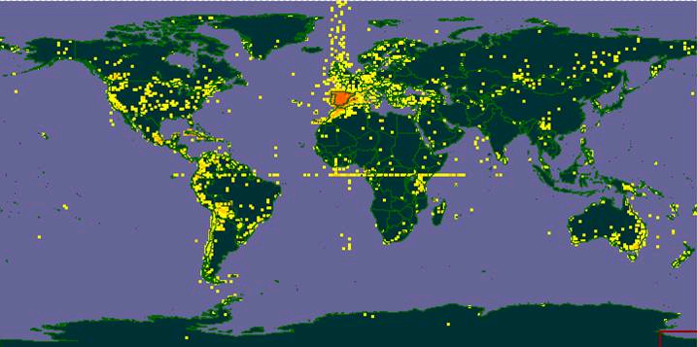
Situation in GBIF Spain(2007)
110 out of 122 datasets using “hosting service”
DIGIR crashes
Room for improvement

Slide 4
We needed an strategy
GBIF is about science; data has to be usable, and re-usable:
Training, tools, tracking, facilitating
That is not all:
Data usefulness depends on each use
No data record will be prevented from being published on the basis of its intrinsic quality
Metadata becomes very important
Analysis & recomendations
Otegui J, Ariño AH, Encinas MA, Pando F (2013) Assessing the Primary Data Hosted by the Spanish Node of the Global Biodiversity Information Facility (GBIF). PLoS ONE 8(1): e55144. doi:10.1371/journal.pone.0055144

Slide 5
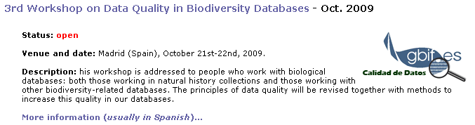
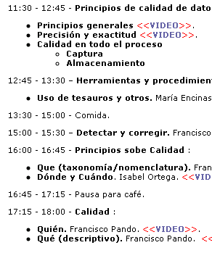
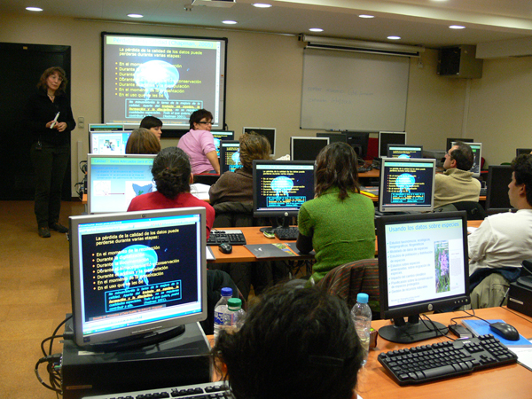
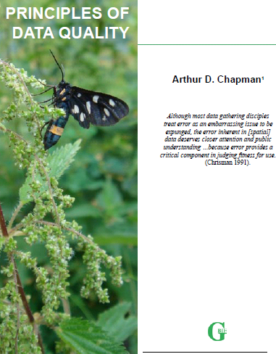
Training
Last one Feb. 2011 (the 5th) and delivered online using eLearning Platform
http://www.gbif.es/formaciondetalles.php?IDForm=46

Slide 6
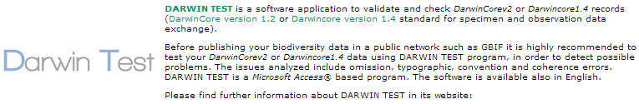
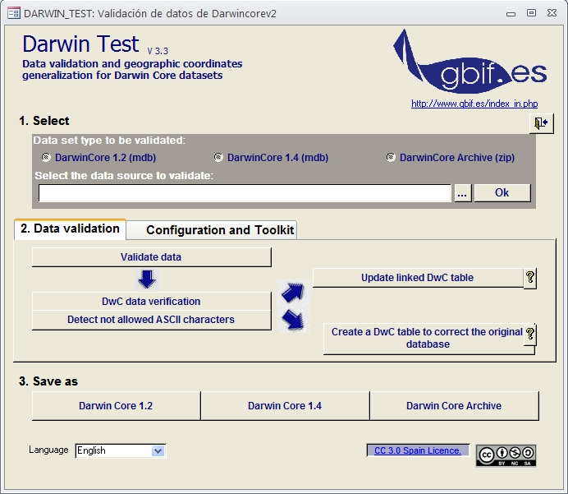
Tool
Two kind of tests
  Technical
    Field names, data types, etc
    Ascii characters
  Content
    Congruence tests
http://www.gbif.es/darwin_test/Darwin_Test_in.php

Slide 7
Tool (Darwin test) deployment
First stage
  Tool used at the coordination unit on "ready to publish datasets”
  Report to data providers
    Technical part: has to be passed
    A FYI report (on content)
2nd stage
  Make it publicly available:
    Offer to all GBIF participants as a services
    Request to users of the hosting service to past the Darwin Test
3rd stage
  Using CoL as controlled vocabulary for scientific names
  Using the Colombia’ss AATs (Archivos de autoridad taxonómica; taxonomic reference archives) as dictionaries for scientific names
  Making Darwin Test multilingual

Slide 8
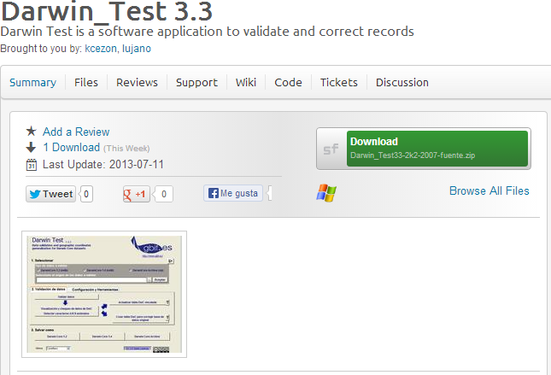
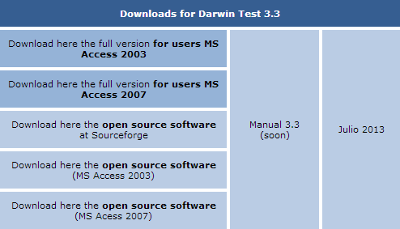
DarwinTest DOWNLOADS
http://www.gbif.es/darwin_test/Darwin_test_in.php
Source code at SourceForge under CCAS license: http://sourceforge.net/projects/darwintest33/

Slide 9
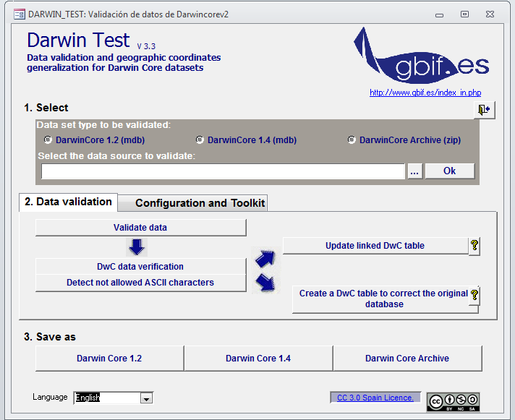





DarwinTest IN ACTION

Slide 10
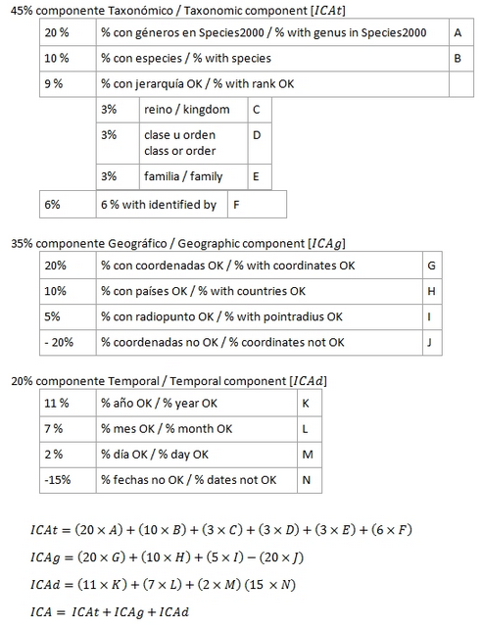
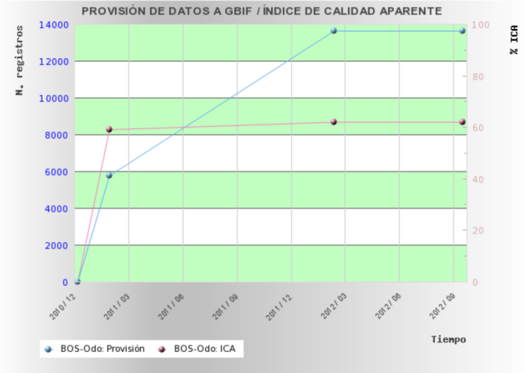
Tracking Data quality
The ICA Apparent Quality Index
http://www.gbif.es/ica.php
Three components (taxonomy, georeferencing, dates)
Calculated on dataset from DT
Improving over time

Slide 11
TRAINING: PROMOTE DQ
Extensive training at gbif.es, first seminar in 2007
International – strong recruitment in the Americas
Materials made publicly available
Repository of DQ materials: BDQ
Notes:
The third main factor in DQ management in Spain is training, carried out by gbif.es. Started in 2007 and has been going on strong, producing a lot of graduates and materials.

Slide 12
DQ TRAINING
Started 2007
On-site workshops:
  III GBIF Workshop on Biodiversity Database Quality (2009)
  http://www.gbif.es/formaciondetalles.php?IDForm=60
  Etc.
On-line workshops:
  E-learning at GBIF.ES: IV Workshop on Biodiversity Database Quality (2013) http://www.gbif.es/formaciondetalles.php?IDForm=109
  Etc.
Video recordings of workshops
http://www.gbif.es/videos/videos.php
Notes:
The courses have two formats: On-site, hands-on courses with trainers, and online workshops. All courses have been made public anyway.

Slide 13
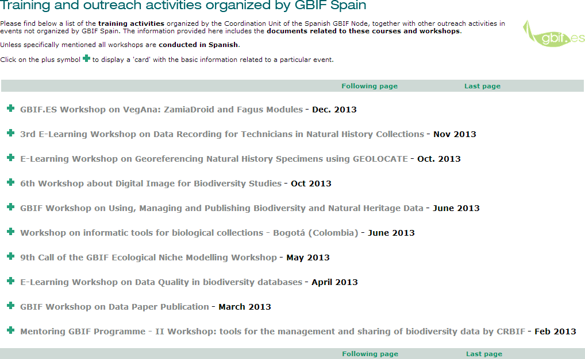
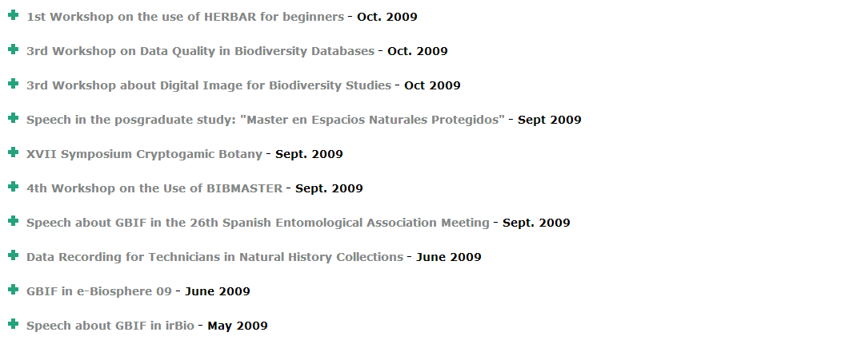
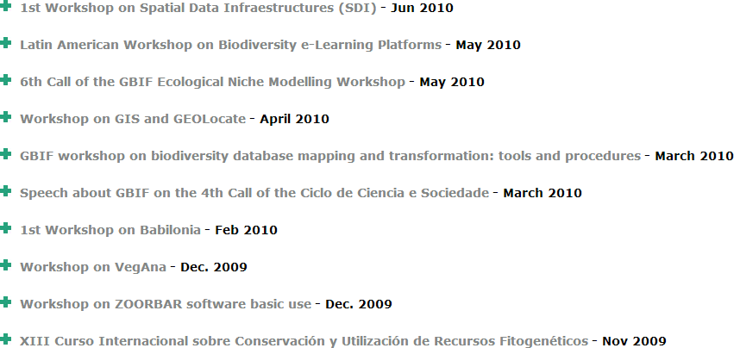
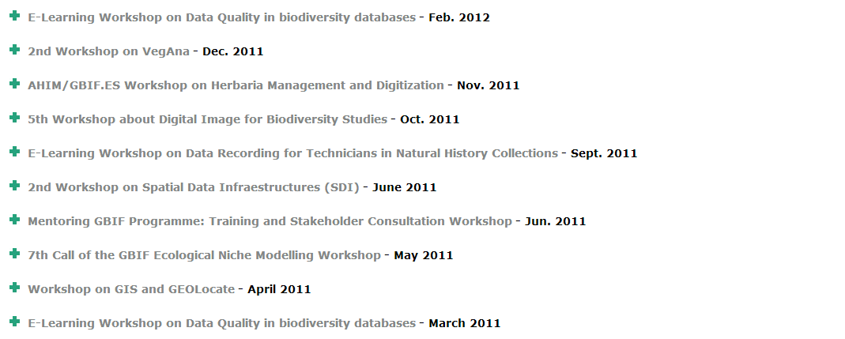
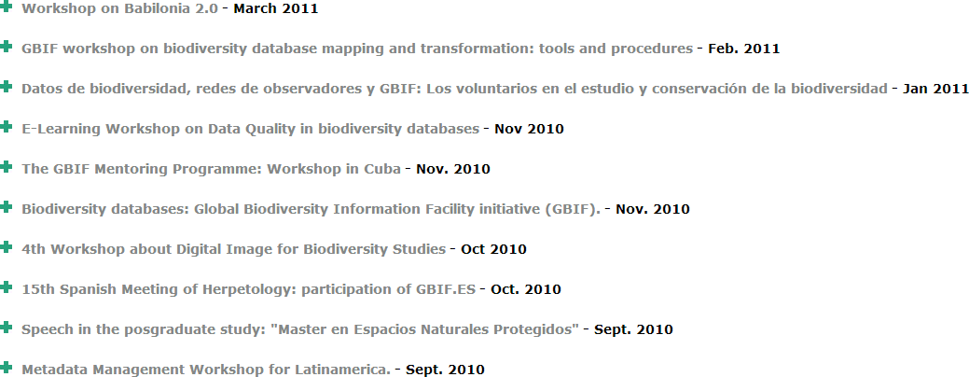
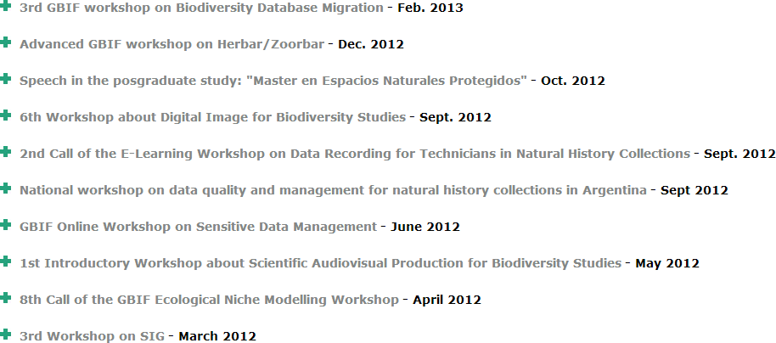
DQ TRAINING
http://www.gbif.es/formacion_in.php
Notes:
Some courses (red arrows) deal specifically with data quality, but there are others that touch on DQ within specific context (green arrows). There is already a long series of courses.

Slide 14
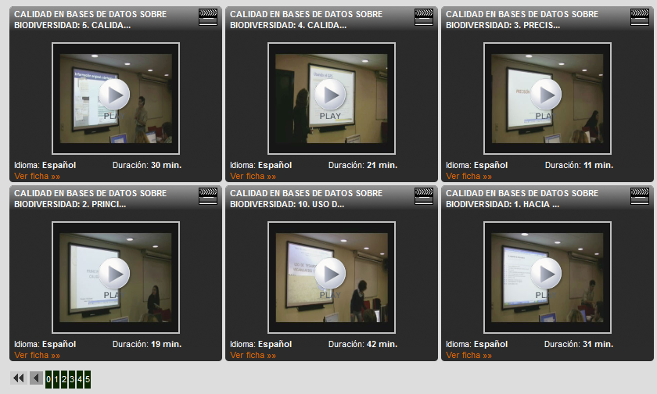
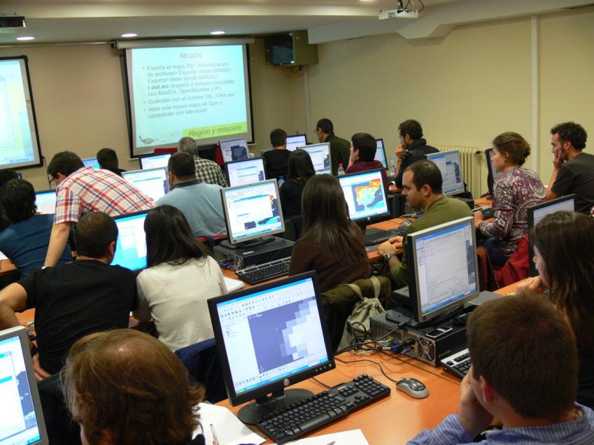
DQ TRAINING: ON SITE
http://www.gbif.es/formaciondetalles.php?IDForm=60
http://www.cienciatk.csic.es/
Notes:
The onsite workshops have been carried out in Madrid but also elsewhere. Video of the onsite workshops is available through the CSIC repository.

Slide 15


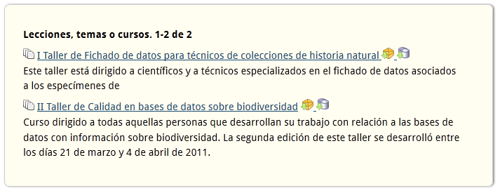
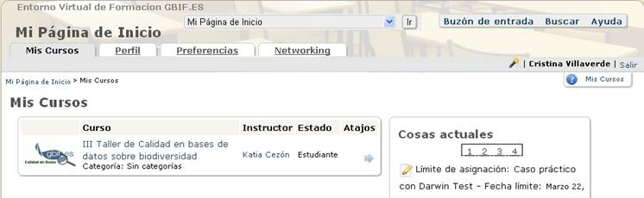
DQ TRAINING: ONLINE
Started 2010, 7 courses so far
Enrollment: 130 students, 16 countries
Two components:
  ATutor, open during the actual courses
    http://elearning.gbif.es/login.php
  AContent, permanent repository for the courses
    http://elearning.gbif.es/AContent/home/index.php
SCORM package
Notes:
Online training relies on an e-learning platform. Started in 2010 and has had a lot of students from several countries. It depends on two components: Atutor, active during the course allowing for interaction, and Acontent, that remains as a course repository once the workshop is finished.

Slide 16
BIODIVERSITY DATA QUALITY HUB
DQ Resource Locator. Proposed at the GBIF European Node Meeting, 2011
Compatible with GBIFS’ ORC
Includes tools, thesauri, training materials, experiences, Prezi presentation
Allows for resource submission
http://www.gbif.es/BDQ
Notes:
Many DQ resources are collected together in a Biodiversity Data Quality Hub, set up at the Spanish node on behalf of other nodes. It is compatible with the Open Resource Center of the GBIF Secretariat and includes tools and materials, as well as links to other DQ resources elsewhere.

Slide 17
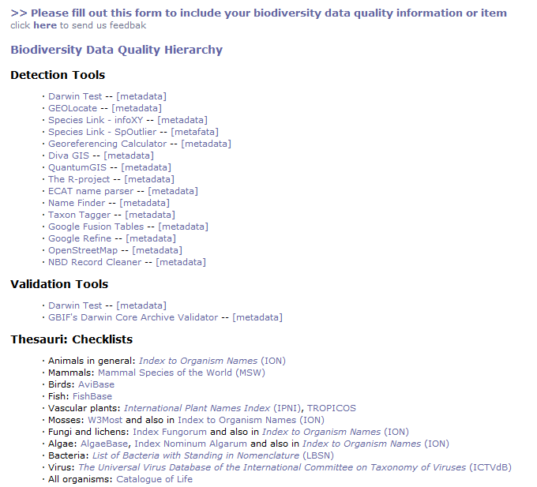
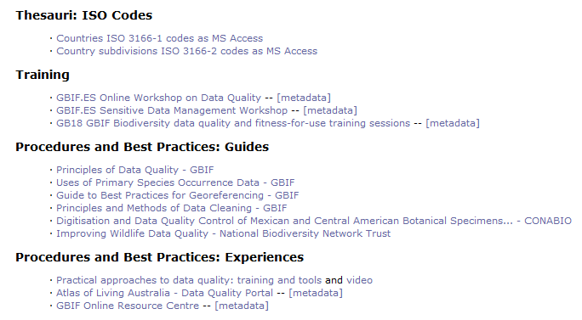

Slide 18
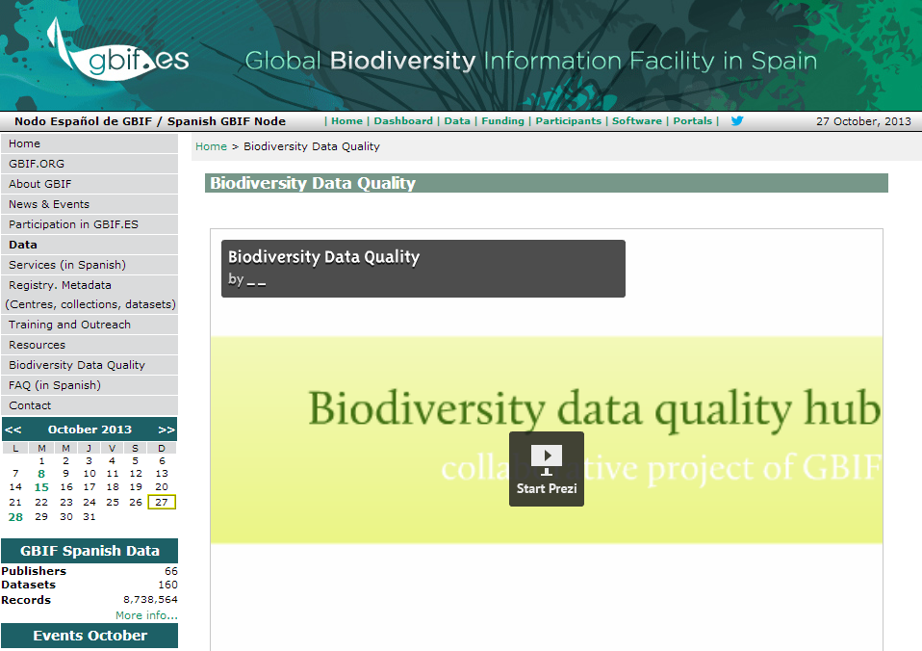
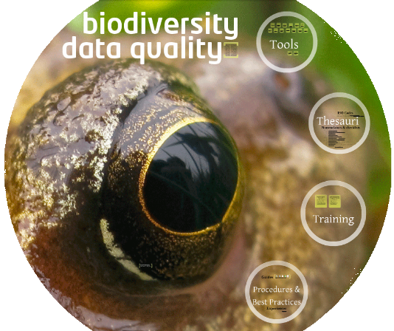
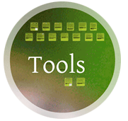

Notes:
There is a nice Prezi presentation, too.

Slide 20

At your service:
Francisco [Paco] Pando (pando@gbif.es)
Director
Unidad de Coordinación de GBIF
Real Jardín Botánico - CSIC
Claudio Moyano 1
28014 Madrid, Spain
pando@gbif.es
www.gbif.es
Phone: + 34 91 420 3017
Fax: + 34 91 420 0157

