Slide 2
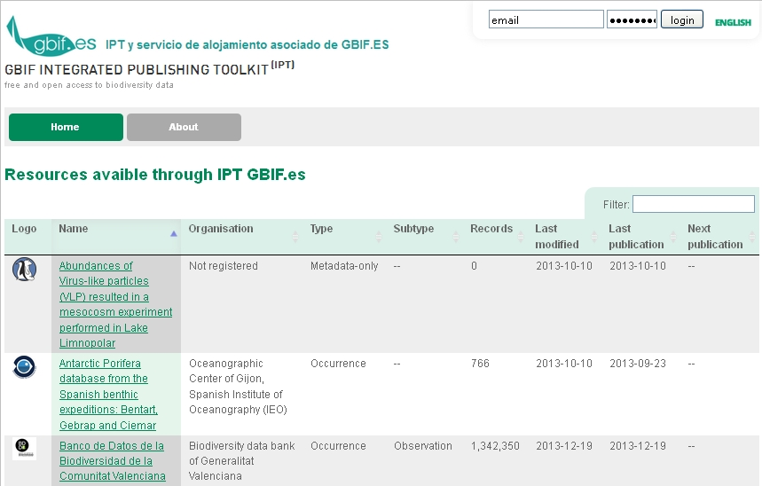
INTEGRATED PUBLISHING TOOLKIT (IPT)
http://www.gbif.es:8080/ipt/

Slide 3
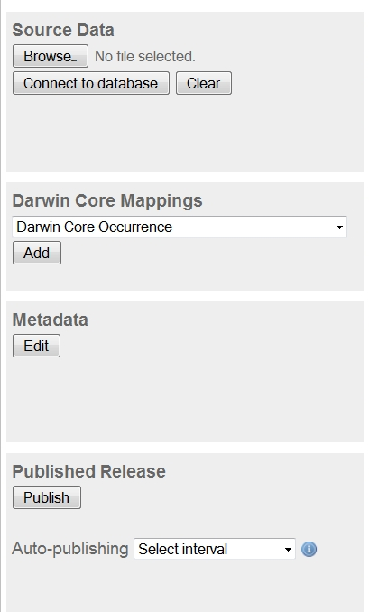
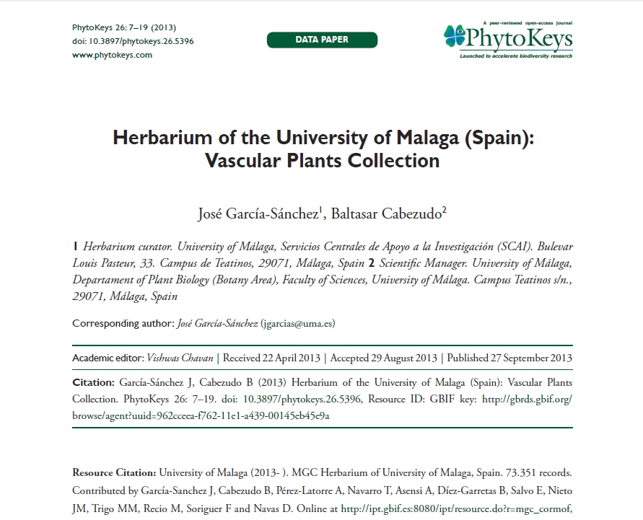
INTEGRATED PUBLISHING TOOLKIT (IPT)
Biodiversity-related information
- Primary taxon occurrence data
- Taxon checklists
General metadata
Data Paper
http://www.gbif.es:8080/ipt/

Slide 4
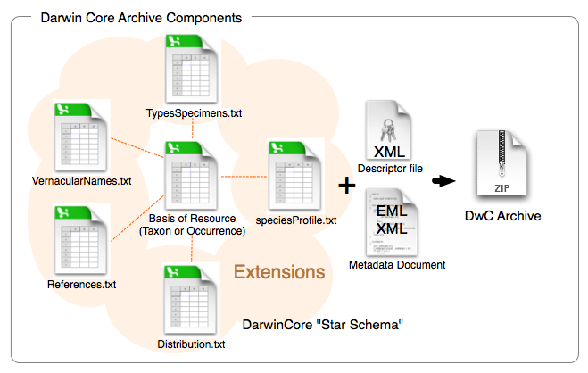
WHAT WE NEED?
DARWIN CORE ARCHIVE
It’s a new standard that makes use of the Darwin Core terms to produce a single, self-contained dataset for species occurrence or checklist data.

Slide 5
WORKFLOW
Dwc standard format adaptation
Validation & data quality control
IPT
Registration at GBIF.org

Slide 6

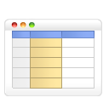

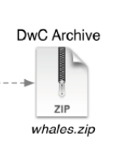
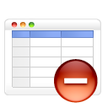

WORKFLOW
Standardize
DwC archive
Herbar
Zoorbar
HZL
DwC 1.2
Darwin Test
Other
software
???????
Personalized
adaptation

Slide 7

WORKFLOW
Validation & data quality control
Satandardice DwCA
IPT
Registration at GBIF.org
- Validation
- Correction
- Delete invalid ASCII
- ICA (Apparent Quality Index)
Validation
Darwin Test
http://tools.gbif.org/dwca-validator/
Checks the Darwin Core Archive (files structure)

Slide 8
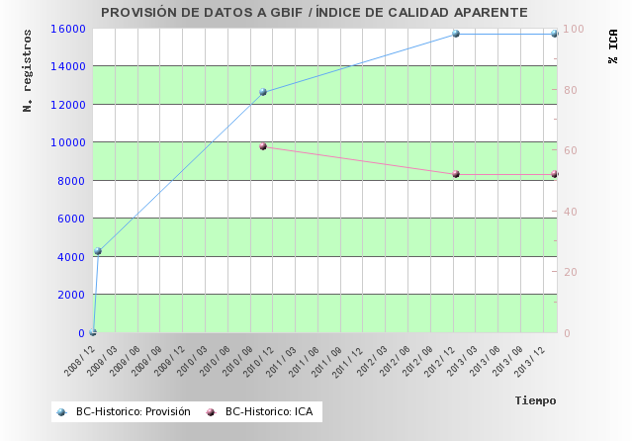
WORKFLOW
Validation & data quality control
Satandardice DwCA
IPT
Registration at GBIF.org
APPARENT QUALITY INDEX (ICA)
An indicator of the data base quality (records, observations, specimens of natural history collections)

Slide 9

WORKFLOW
Validation & data quality control
Satandardice DwCA
IPT
Registration at GBIF.org
Validation
Darwin Test

Slide 10

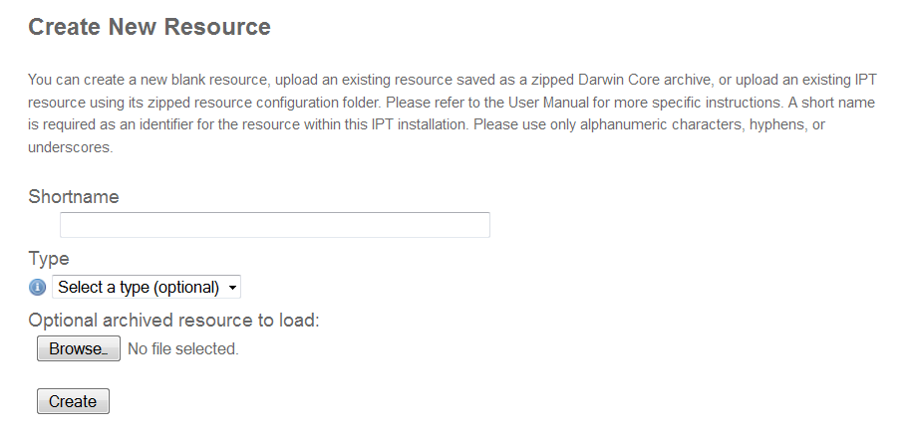
WORKFLOW
IPT
Satandardice DwCA
Validation & data quality control
Registration at GBIF.org

Slide 11
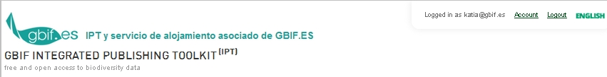
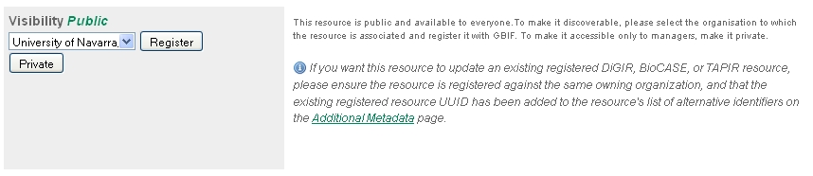
WORKFLOW
Registration at GBIF.org
Satandardice DwCA
Validation & data quality control
IPT

Slide 12
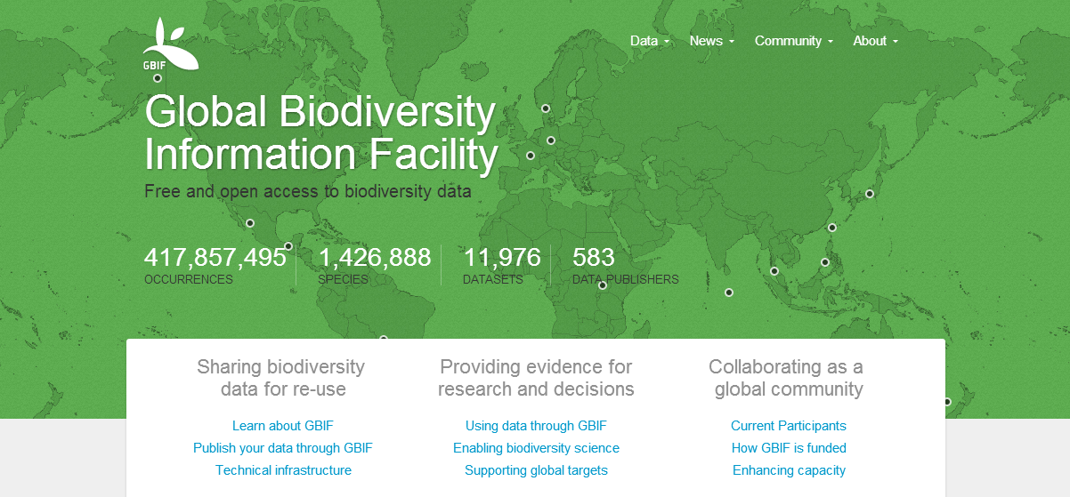
WORKFLOW
Registration at GBIF.org
Satandardice DwCA
Validation & data quality control
IPT

Slide 13
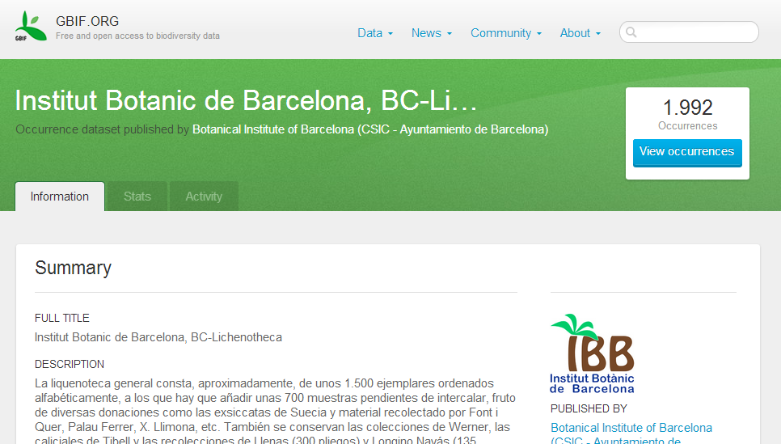
WORKFLOW
Registration at GBIF.org
Satandardice DwCA
Validation & data quality control
IPT

Slide 14
Thank you

