Slide 2
SUMMARY
GBIF Spain:
  Structure
  Institutional framework
  Services
  Spanish Participants
  Community strategy
  Training
  ICT (Information and Communication Technologies)
Notes:
As an introduction to this mentoring I’m going to talk a bit about us, about the Spanish GBIF Node. Here you can see the topics I will introduce. The structure and staff of the Node, the institutional framework, the services we offer, the most important ones, some about spanish participants: where they come from, how many records we share, the data provision evolution, the strategy we try to implement, some about training which is a very important area in this node and finally , we will have a glance at our informatic infraestructure.
I would like to apologize for my English, I will try to make myself clear but if you don’t understand something just stop me and I’ll take it again.

Slide 3
STRUCTURE
  Coordination Unit hosted in the Royal Botanical Garden CSIC
  Working since 2004
  Structured as a network (Coordination Unit + centers)
GBIF Spain = Coordination Unit + Projects & Centers
Francisco Pando
Node Manager
Carmen
Developer
Katia
Users support. Documentation. Training
Santiago
Developer. Infraestructure maintenance
Cristina
Web content. Training coordinator
Notes:
You are right now at the Royal Botanical Garden of Madrid. This Garden hosts the Coordination Unit of the Spanish GBIF Node since 2004 when it was created, so this year is our 10th anniversary.
The Spanish GBIF Node is structured as a network, in one side there is a Coordination Unit that is where you are now, formed currently by Paco as the node manager and 4 more people who are Carmen, who is the software developer of all of our informatic applications. She is currently on maternity leave, in fact she’s giving bith right now twins. Katia who is the tester of all these applications I have just mentioned. She is also the users support officer. When somebody has problems implementing some of our tools Katia is the one who helps them (by phone, by email, by remote, or even in situ). And she is also the e-learning manager, so she will be in charge to tell you more about this topic tomorrow. Then, we have Santiago whose tasks are programing and maintaining the informatic infraestructe, among others. Later I’ll go a bit deepr in this topic. And me, that I deal with the content of the web page and the coordination of our training courses. We used to be more people but right now we are just this. We hope to include a project coordinator soon.
And on the other side, we have the centres and institutions who participate provinding data: universities, museums, ministries, public administrations, etc…

Slide 4




FRAMEWORK
  Depending on the Ministry of Economy and Competitiveness
New Government since 2012: heavy changes
No “Ministry of Science”
No digitalization RFP
Budget for GBIF.ES cut
Budget for science cut
We compete for funds now
…still working
2000-2004
2004-2008
2008- 2012
2012- 2013
Notes:
Since the Spanish Node was created in 2004 there has been four different political scenes. We have been depending on four different Ministries due to political changes. Most of the time it used to be the Ministry of Science but since we change the government in 2012 there is no specific Ministry if Science anymore and right now, our budget depends on the Ministry of Economy and Competitiveness. In this current scenario there are no budget for digitization projects, the budget for the coordination unit has been cut a 30% and we do not pay the GBIF membership since two years. So we are fighting to survive and find funds where it is possible.

Slide 5
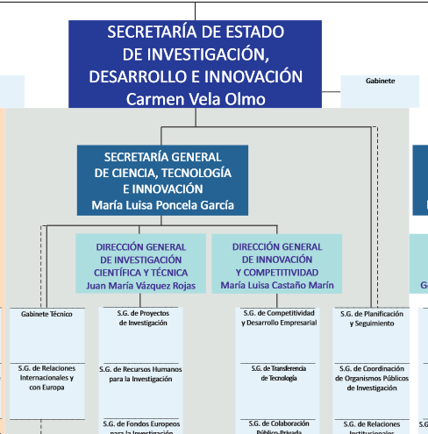
Linkages to Ministry departments
Funds for digitization
≈500.000 €/year
Funds for Coordination Unit
≈400.000 €/year
GBIF membership
≈190.000 €/year
Notes:
This shows specifically where we belong inside the Ministry. It is something like the International and Europe relations Department. Here you can see the money that was dedicated to pay the membership of GBIF, how much we receive for the Coordination Unit and the funds for digitization. But now these two have dessapeard.

Slide 6
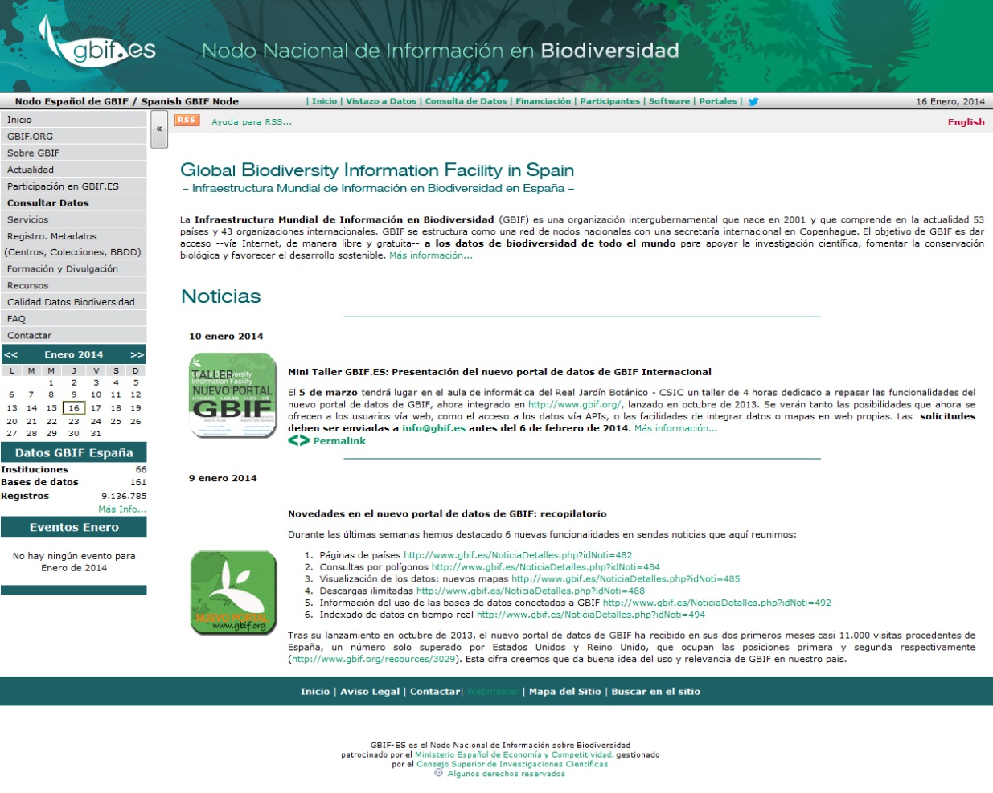
SERVICES: PORTALS
Communication portal
  www.gbif.es
Notes:
Now I would like to introduce some of our services begining with the communication portal. This is the url and this is the look of our web page. It is the same web since 2004 but we recently did some changes to make it a bit more modern and clear.

Slide 7
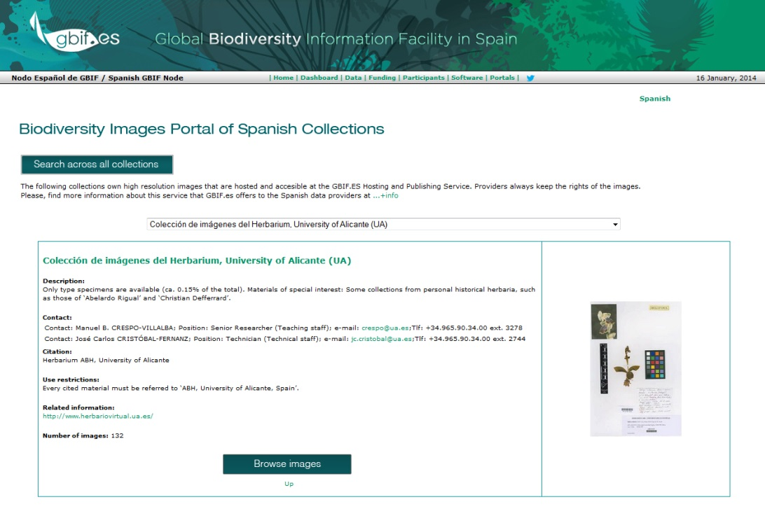
SERVICES: PORTALS
Hosting services:
DIGIR/TAPIR
&
IPT
http://www.gbif.es:8080/ipt/
  Data > 9,000,000
GBIF Spain Biodiversity Images Portal
http://www.gbif.es/Imagenes_in.php
  Images > 27,000
Notes:
The Coordination Unit provides hosting and publishing services of data and images.
We used to have a data portal built on digir and tapir protocols. It is currently down as we decided to better develop a new one instead of investing efforts in repairing the old one. And we have since more or less one year the Spanish IPT working to publish the Spanish datasets in GBIF network. We hope to have a data portal along this year. But I will talk a bit more about this at the end of this presentation.
We do have a Biodiversity Images portal that hosts high resolution biodiversity images only for those who are GBIF providers. It is currently hosting more than 27 thousand images from around 30 collections. This portal allows users to see images in great detail, it is possible to browse through all images and see the metadata associated. We expect to increase the number of image collections along this year.

Slide 8







SERVICES: SOFTWARE
Software of Collections and Projects management
Software of Validation and Transformation
http://www.gbif.es/Recursos_in.php?&#tabs-3
Notes:
Here you can see the kind of appplications we develop. We have a set of applications for collection management: herbar for botanical collections, zoorbar for zoological collections, hzl ligher than the other and can be used for either botanical and zoological collections. BIBMASTER is a database application to manage biodiversity information, specially focused in bibliography and nomenclatural information. And then we have spftware of validation and transformation where I would like to highlight Darwin Test for validate and check DarwinCorev2 or Darwincore1.4 records. Katia will tell you more about this tool after lunch.

Slide 9
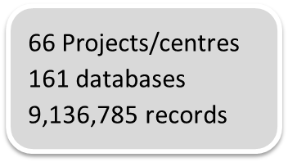
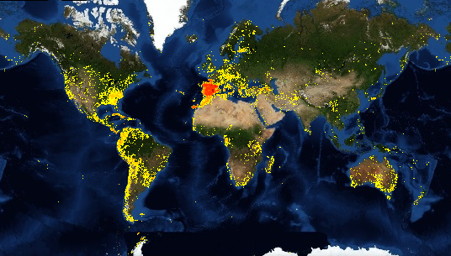
CONTENT
http://www.gbif.org/country/ES
Notes:
This a picture to show the data that comes from Spain. A total of more than 9 million records from 161 databases and 66 projects or institutions.

Slide 10
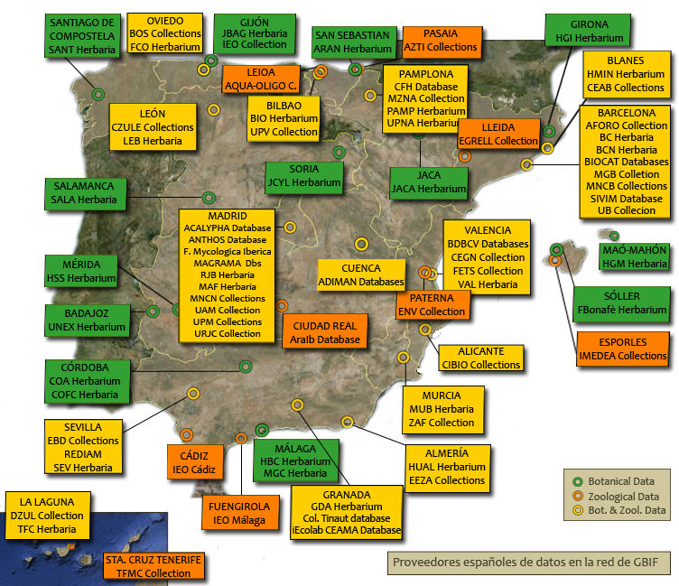
CONTENT
Spanish data providers
Notes:
Here you can have an idea of where the data comes from

Slide 11
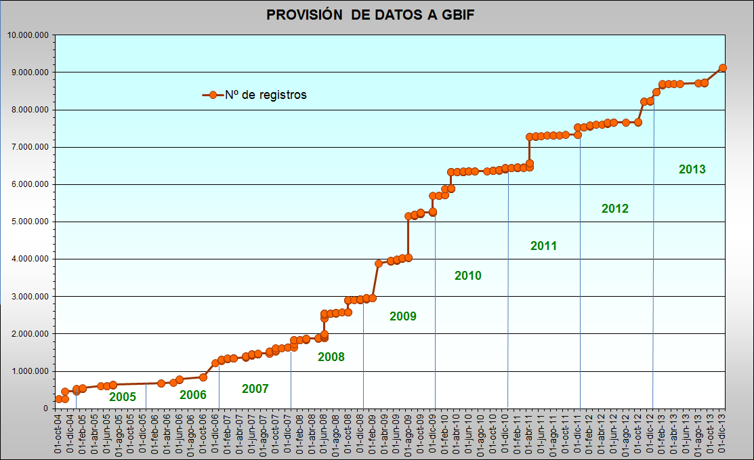
CONTENT
Spanish data provision
Notes:
This is a figure to show the Spanish data provision from 2004 until 2013. It has been constantly increasing although the recent economic situation does not help many centers to digitize recrods, as we saw before.

Slide 12
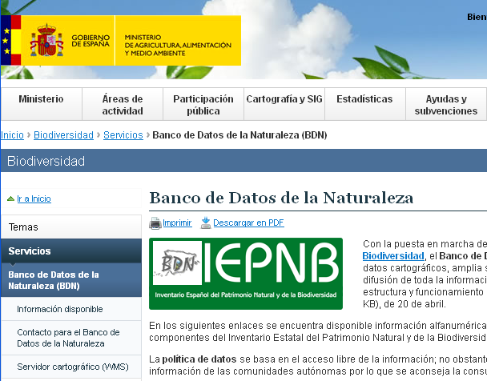
COMMUNITY STRATEGY
GBIF Spain is member of the IEPNB Committee
Notes:
To talk a bit about our community Strategy we would like to stress the effort we make in involving as many agents related to biodiversity information as possible.
First of all I’d like to mention that we have a seat in the IEPBN (Inventario Español del Patrimonio Natural y de la Biodiversidad, Spanish Inventaryy of Biodiversity and Natural Heritage) Commite that depends of the Ministry of Environment.
This commite is in charge of controlling all the biodiversity information that is generated in Spain.
Somos parte del Comité del IEPBN que se encarga de generar y supervisar la información ambiental que se genera en España

Slide 13


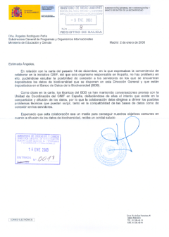



Institutional agreements with regional Goverments
Collaboration with Ministry of Agriculture and Environment
… This is just the begining: NGOs, C.microorganisms, other administrations, etc.
Agreement with National Geographic Institute
GBIF.ES goes beyond Academia
Notes:
Collaboration with ministry of Environment as I said, with the National Geographic Institute to show cartographic information and also to collaborate in the implementation of the INSPIRE Directive.
We also work with local and regional administrations or governments.
In fact, we want to work with all agents that deal with biodiversity information. That is our goal. Not just people from Scientific Areas but to try to go beyond.
jQueremos trabajar con todos los agentes que manejan este tipo de datos: administraciones publicas, etc.

Slide 14
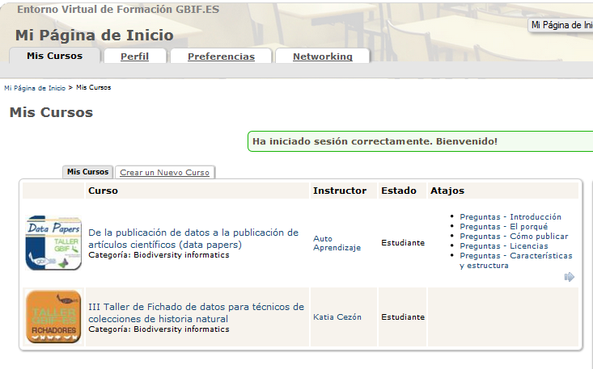
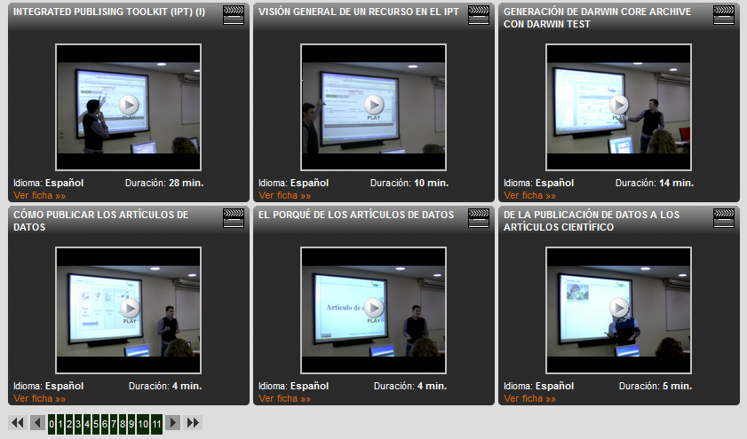
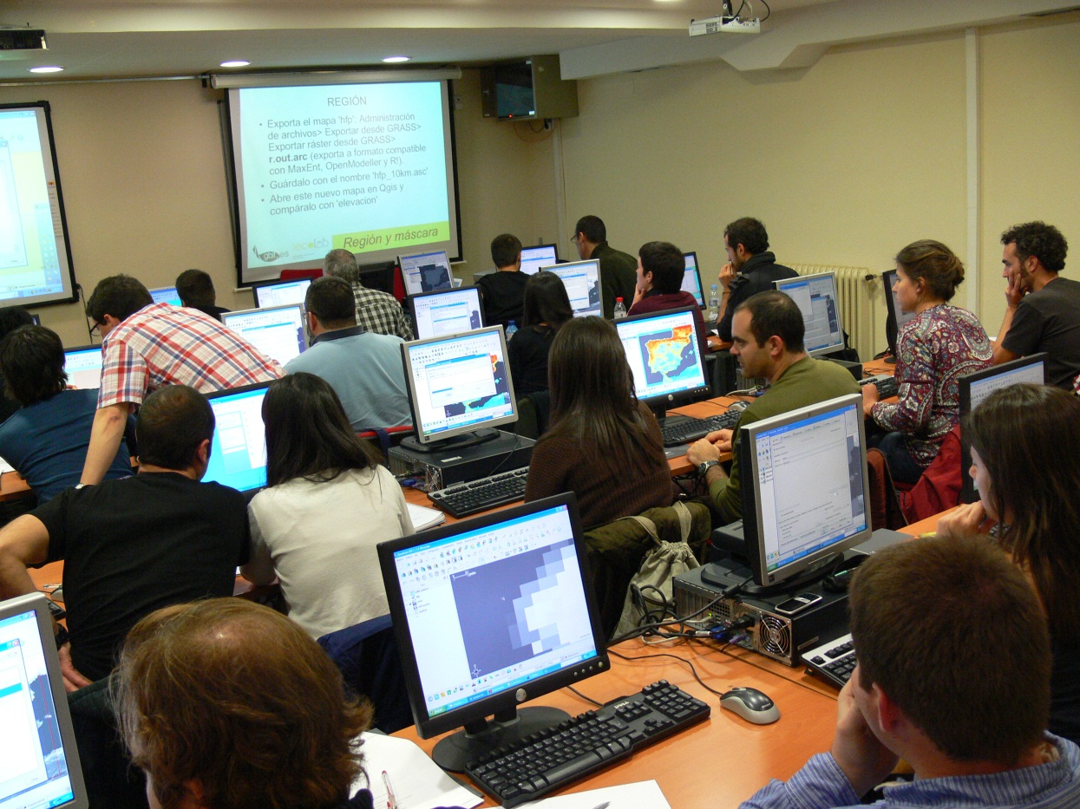
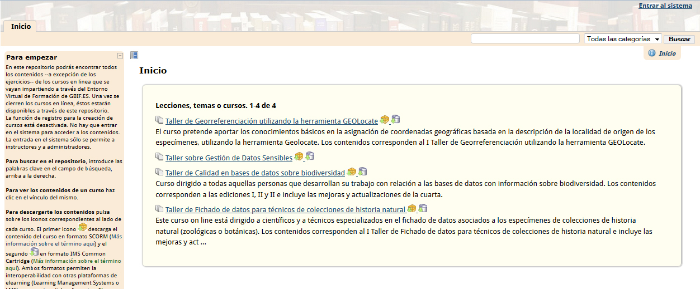
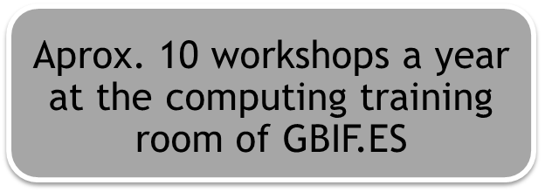
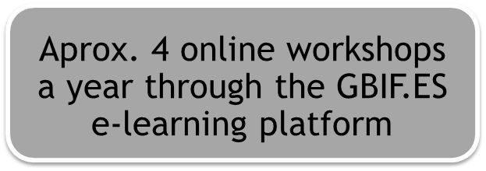
PARTICIPATION: TRAINING
Notes:
Aprox 10 presential workshops a year
And 4 online courses
We use Atutor for perfroming the courses and Acontent as a permanent repository of the course contents

Slide 15
PARTICIPATION: TRAINING
e-Learning
  Consolidating & expanding
  Courses available:
    data entry
    data quality
    sensitive data
    georeferencing
    data papers
Notes:
Online training plan
Each year we offer a new online course more or less
Here you can see the online courses we have arranged:
Ther is a very high demand. i.e. 90 subscription for the georeferencing workshop
We try to have Half spanish / half latinamerican audience

Slide 16
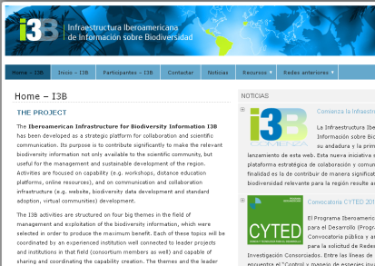

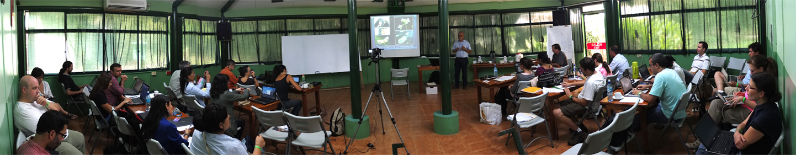
PARTICIPATION: LINKAGES WITH LATINAMERICA
IberoAmerican Infrastructure for Biodiversity Information (I3B)
www.recibio.net
2012 - Biological Collections 3.0 – Villa de Leyva, Colombia
2013 – Biodiversity Information for Environment Conservation – La Selva Biological Station, Costa Rica
2014 – Ecological Niche Modelling– México
Notes:
Just some lines to mention that we have strong links with the latinamerica community.
Currently we coordinate the IberoAmerican Infrastructure for Biodiversity Information (I3B)
The Activities of this platform are focused on capability (e.g. workshops, distance education platforms, online resources), and on communication and collaboration infrastructure (e.g. website, biodiversity data development and standard adoption, virtual communities, forum) development.
Ther are 4 workshops planned for for years. You can see here the ones that have been already organised. And this year we have the third one about ecological niche modelling that will take place in Mexico.
website

Slide 17
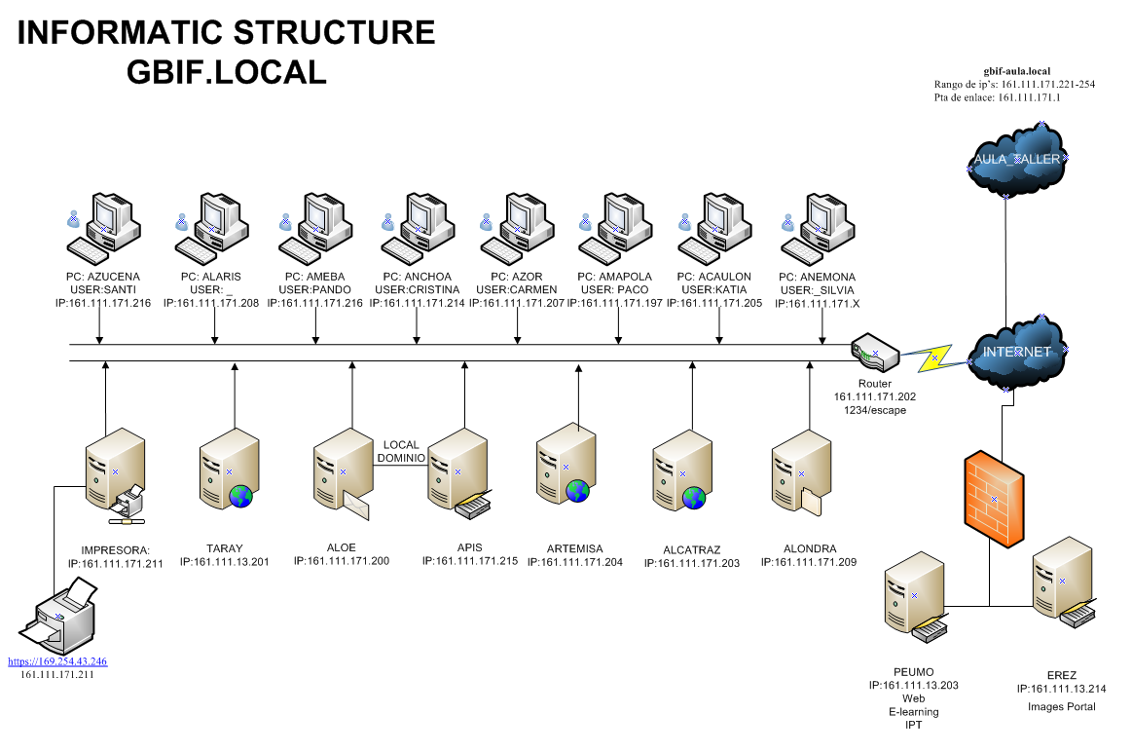
Notes:
A glance of our technologic infraestructure. We have a local network for the office, a network for the informatic room. And two servers one for the images portal and other for the webs, the elearning platform and the IPT.
Infraestructura tecnológica: red oficina y red aula

Slide 18
CHALLENGES
Keeping Funding level
Consolidating HHRR
Maintaining interest of content providers
Expanding data types and tasks to better serve the national needs
Creating the next generation of researchers and professionals
New Data portal
Adapting to the new reality (IPBES, Lifewatch, INSPIRE, others)
This mentoring
Plinian Core http://code.google.com/p/pliniancore - TDWG
Persistent identifiers (moving towards semantic web and a true national infrastructure for enviromental data and information
Notes:
To finish and as a summery I would like to mention some upcoming challenges.
We need to find how to keep the funding level because as I said the Budget has been cut
TRy to consolidate the human resources of the UdC
Try that providers update their databases not just one time and forget about it. One good strategy could be the data papers.
Not just data but deal with other components that are also important for the nation: as images, habitats, species information
Not be stuck in the same scenario but flow to other contexts out of GBIF such us universities, this to become a subjet in master programme, something like that
New data portal using the Atlas of Living Australia model. Not begin from zero but using something that we know is working well and collaborate beetween nodes.
Be part of other related initiatives such as IPBES, Lifewatch, INSPIRE, work on how to integrate them all instead of working all by their own.
This mentoring as a way to share goals, collaborate and be efficient.
The work group of Plinian Core
Similitud de objetivos, importacia de la colaboración para no hacer todos todo. Ganamos todos en eficiencia. Plinian Core is a standard oriented to share species level information. Its hierarchical schema allows to develop species data sheets that can be shown in websites. Task group of TdWG (Biodiversity Information Standars)
Usar el modelo de ALA for implementing data portal
Use PI en nuestras herramientas, para nombres, para taxones, taller,
IPBES = ipcc pero con la biodiversidad. Hacer predicciones y proponer recomendaciones por la perdida de biodiversidad. Datos fundamentales para hacer esto. Intentar que IPBES cuente con toda la infraestructura de GBIF a nivel inter y nacional. involucrarnos.
Ser parte de lifewatch, reunión en granada…
Inspire
Continuidad del node manager, tiene que ser del CSIC, cómo se busca, tareas, etc.
Imágenes y otros temas como hábitas o info de especies que se salen un poco pero son componentes fundamentales. Nodo nacional sirve a la nación…

Slide 19
THANK YOU

