Slide 1
Architecture overview
Running a Living Atlas for your node
GBIF CESP Workshop, Madrid 2018
Dave Martin

Slide 2
Running a Living Atlas
Why run a Living Atlas?
Sharing (is caring)
Architecture of the ALA
Principles
Core components

Slide 3
Why run a Living Atlas?
Be part of a development community
Open source tools
No licencing costs etc
ALA maintaining components
GBIF nodes - typically < 1 FTE developer
Can be difficult to retain developers
Integration with GBIF
Support TDWG standards

Slide 4
Why run a Living Atlas?
Local taxonomy support
Sensitive data
Expose datasets that not shared with GBIF
Start process to share globally
Add regional reporting
Incorporate legislative lists for your country
Be the biodiversity hub for your country
Notes:
Be the biodiversity hub for your country...

Slide 5
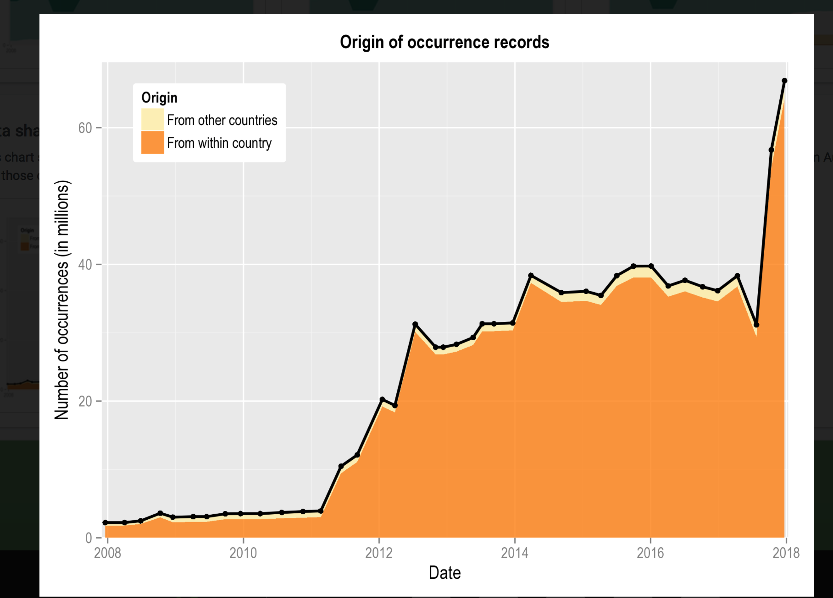
Why run a Living Atlas?
Support research community in your country
Galvanise data exposure efforts
Pre-ALA, 6m records AU
And poor currency
Today, 60 million+
Provide a focal point
Engagement
Citizen science
Government

Slide 6
And it’s all free … ?
Hosting costs
ALA use EC2 & other data centres in Australia
Other nodes use e-Research infrastructures
Hosting can be expensive
Maintenance costs
Applying bug fixes
Deploying updates
Notes:
Main

Slide 7
Sharing (is caring)
ALA supports a ”hub” model
1 infrastructure, lots of (pretty) faces
Hubs can be regional, taxonomic, thematic
Nodes can share:
Developer time - collaboration
Infrastructure costs / maintenance

Slide 8
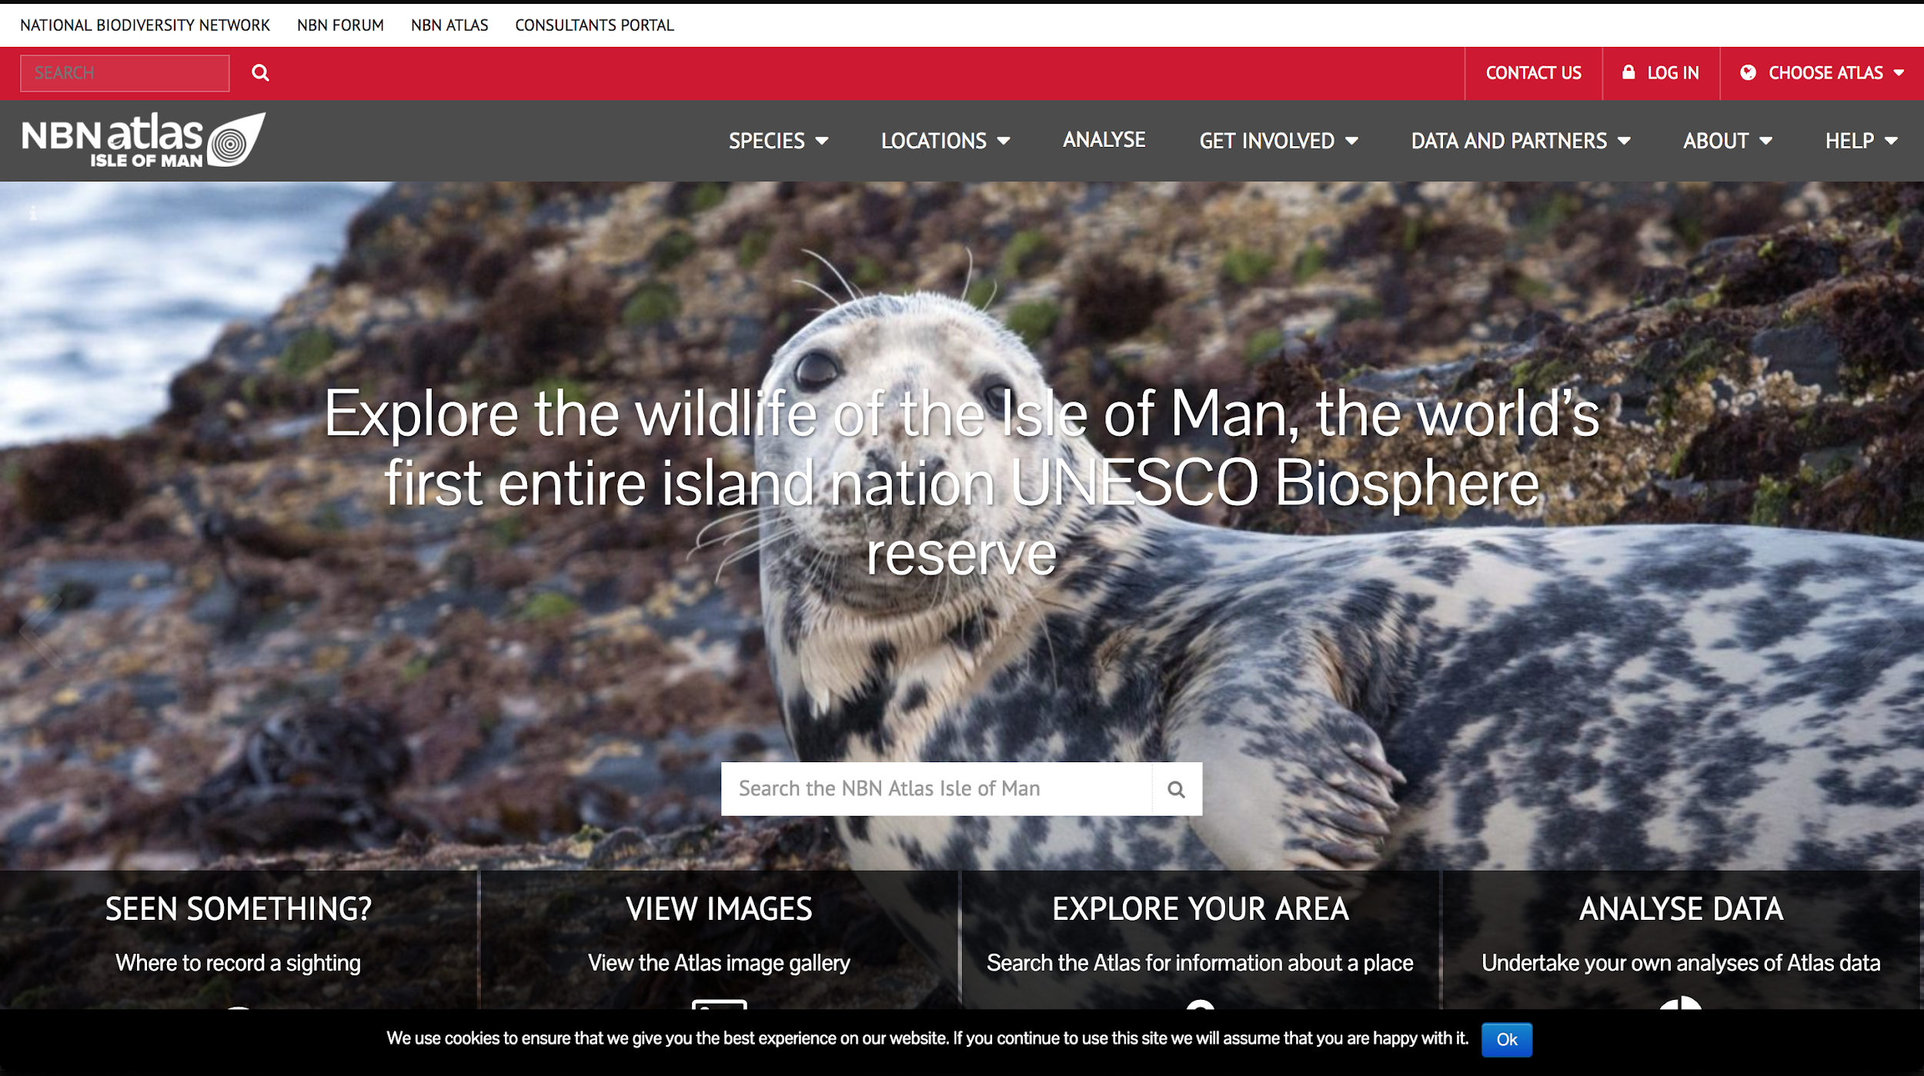
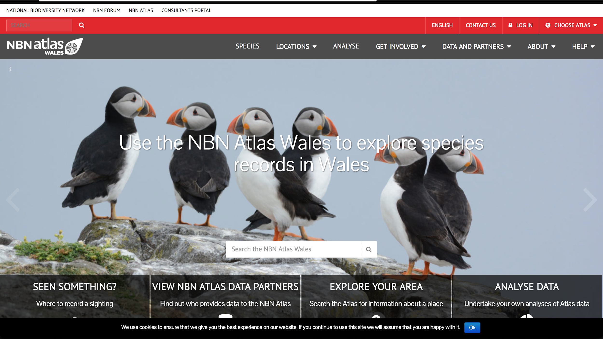
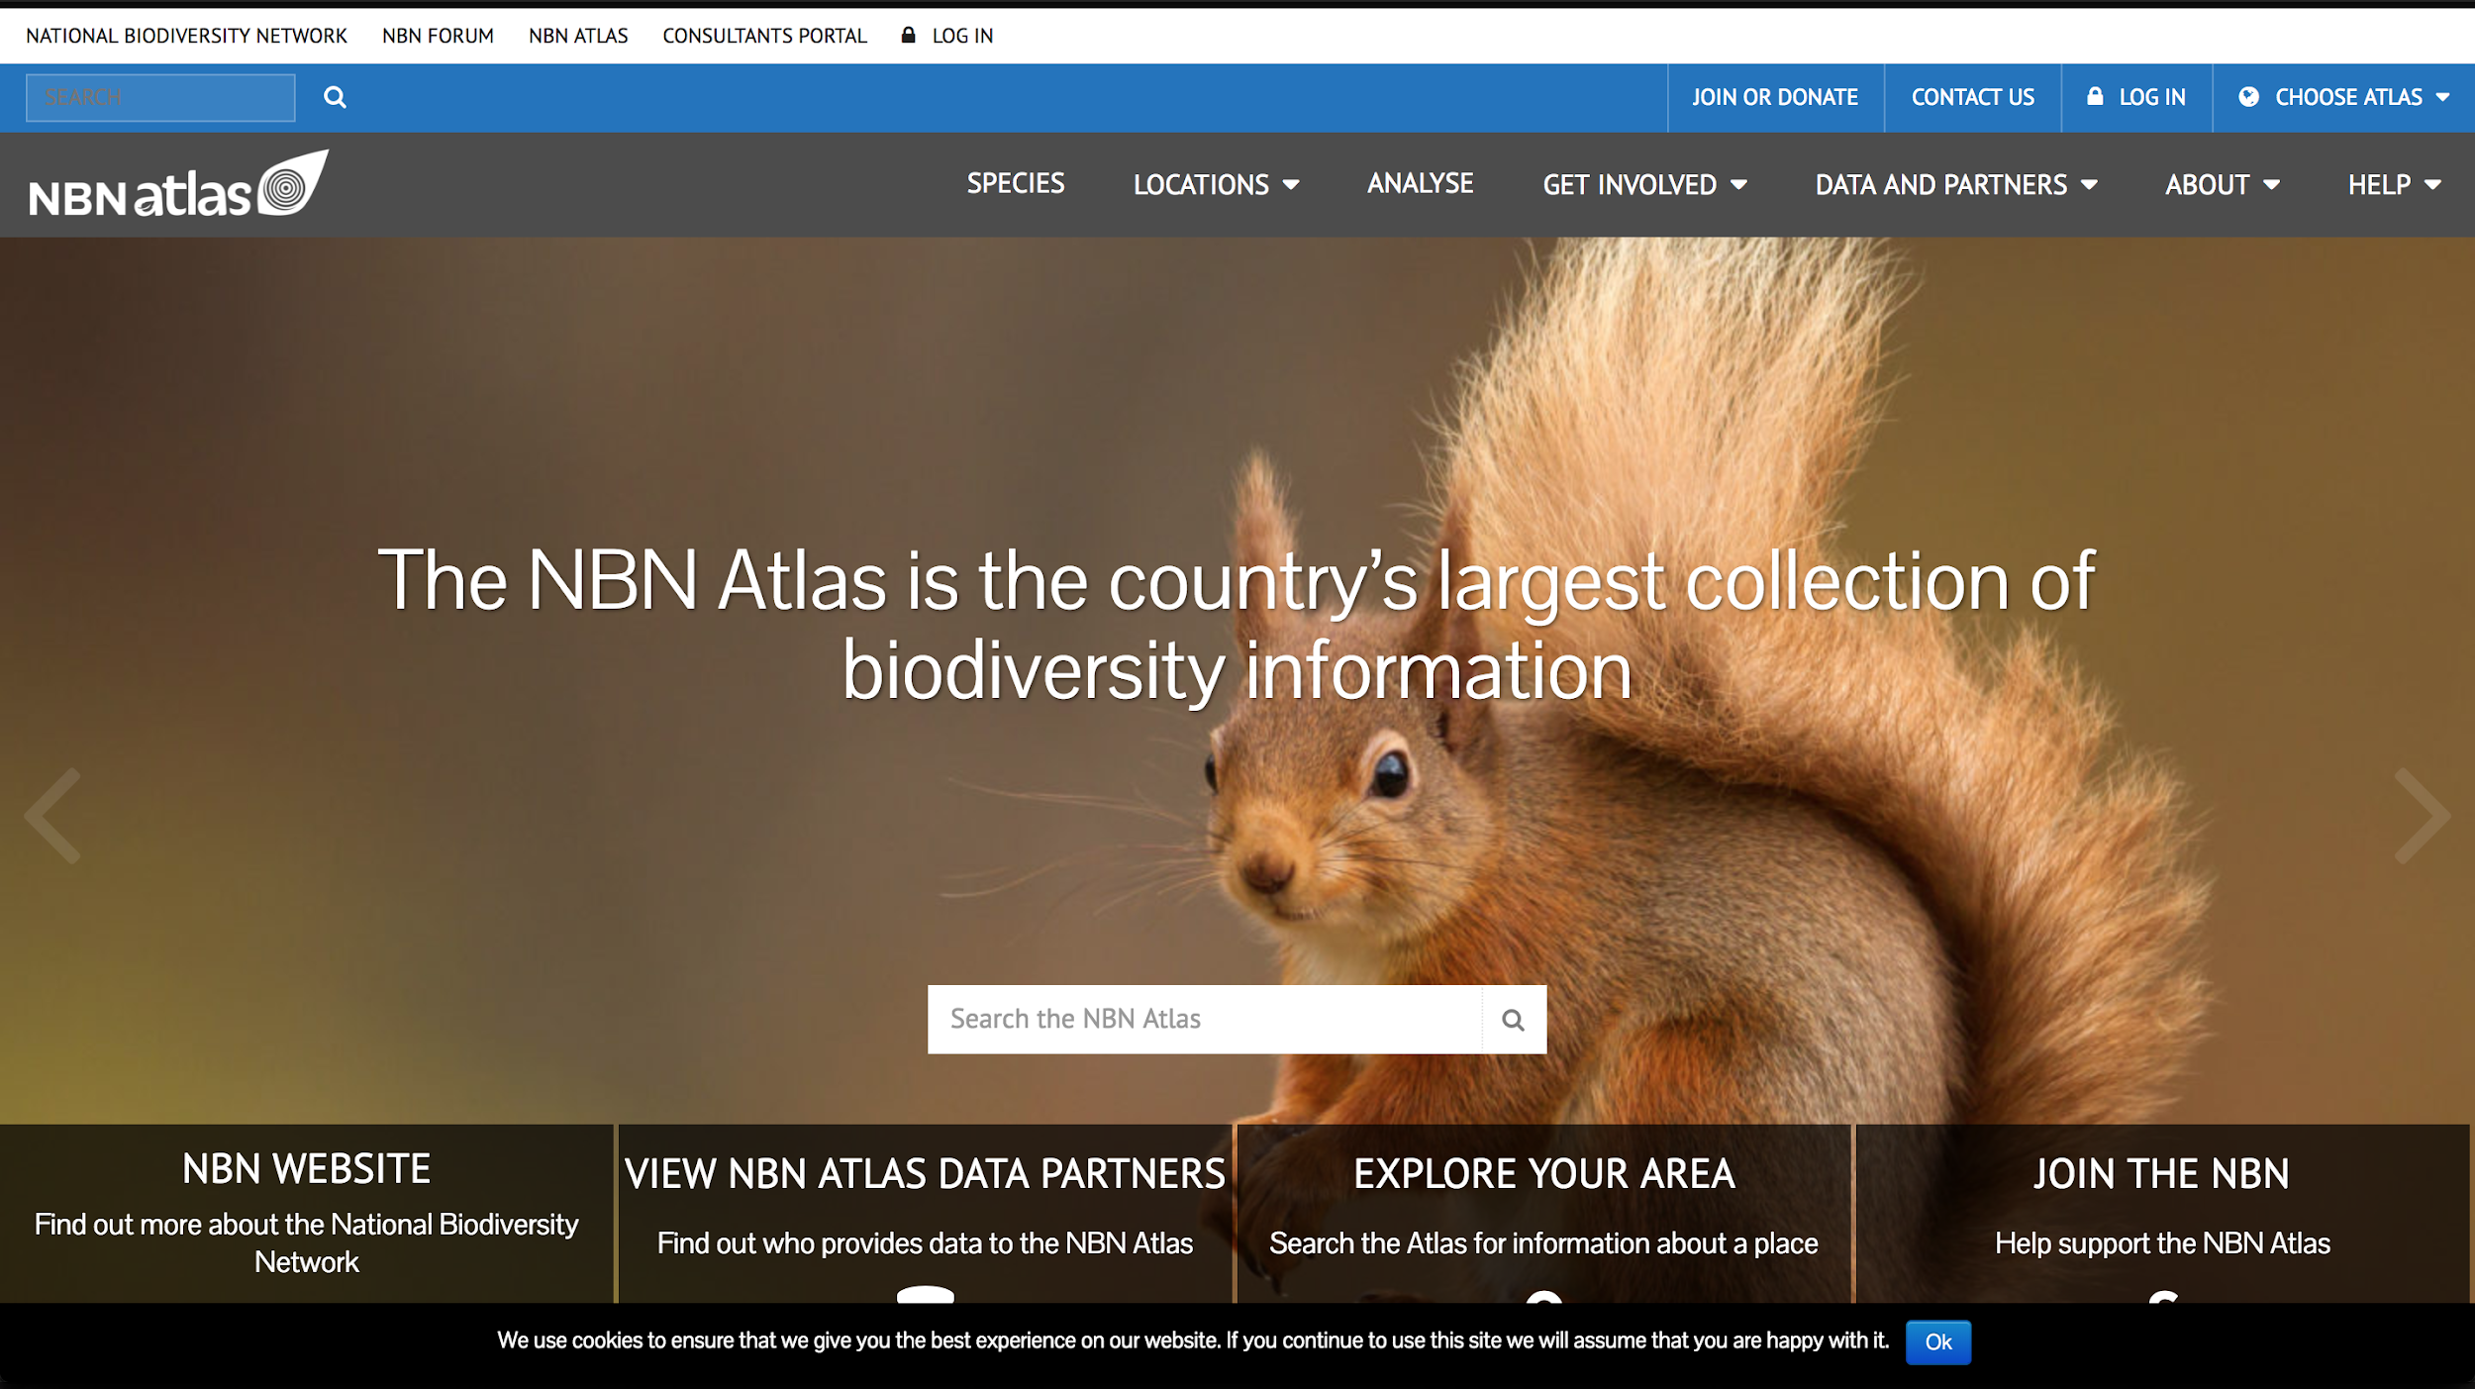
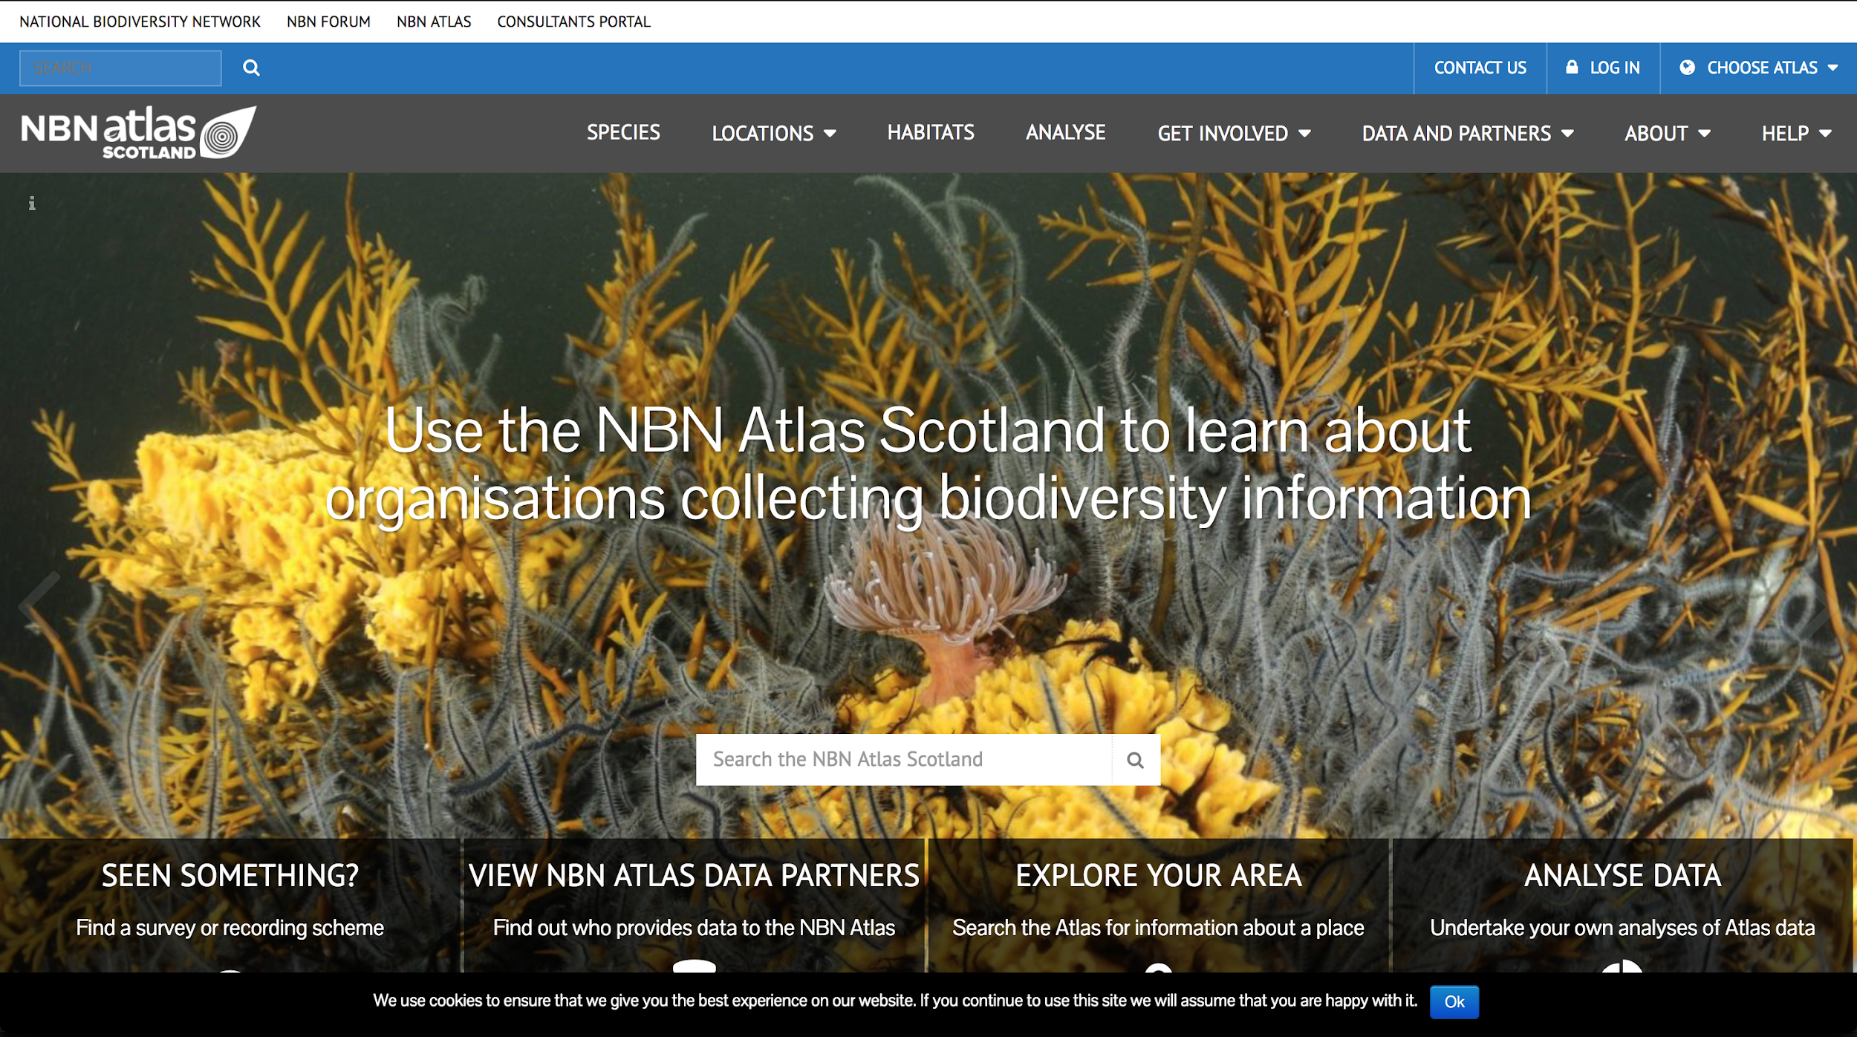

Slide 9
Architecture
Micro services
Many components
Wired together with configuration
Communication via web services only
Can start with a simple core
Add additional components later on

Slide 10
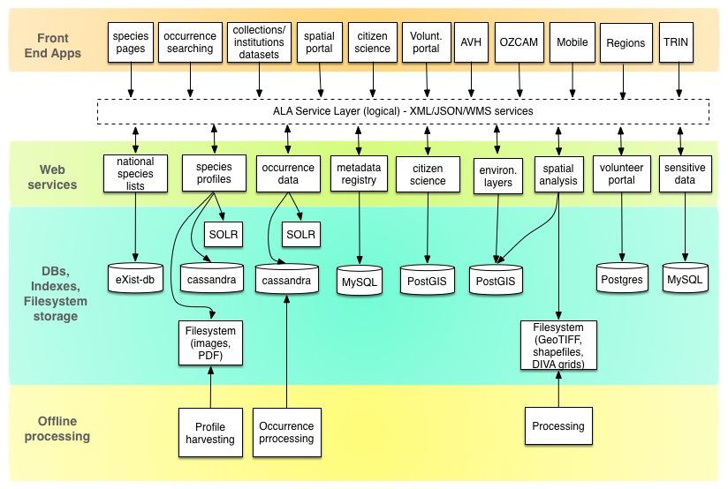
Notes:
* Microservices architecture
* Lots of components
* Each with different needs

Slide 11
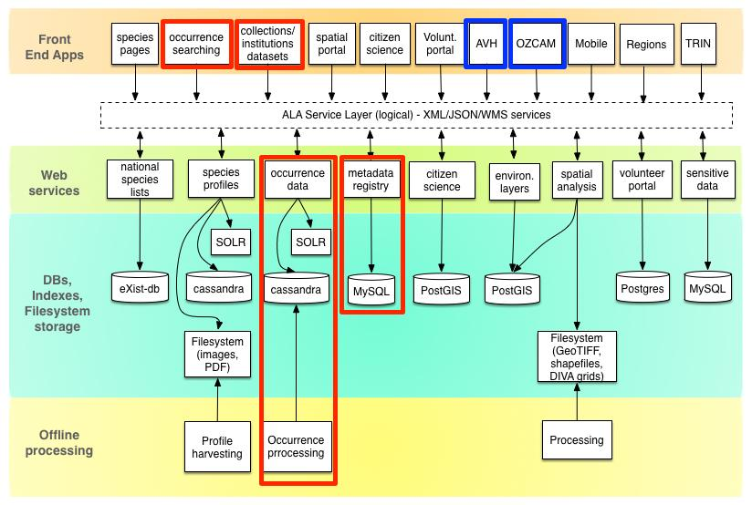
Notes:
Core set of components

Slide 12
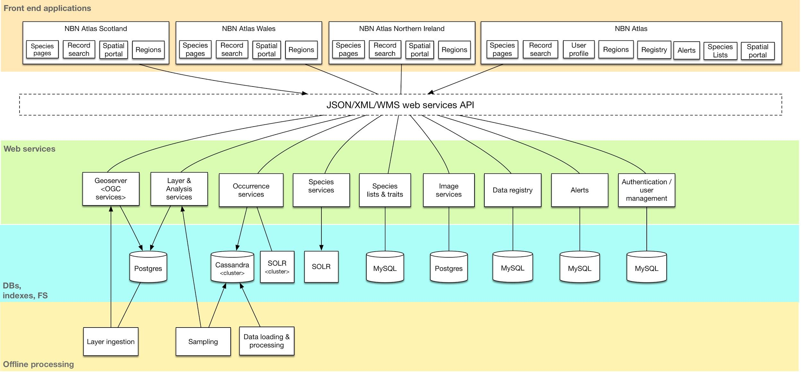

Slide 13
Principles
Open source - Github
Ansible for deployments
External configuration files
Grails plugins

Slide 14
Principles
Basic requirements for reuse
Skinning / rebranding
Inventories - configuration
Hosting
No customisation should be required to reuse

Slide 15
Core components
Collectory
Biocache services
Biocache hub
Name indexes

Slide 16
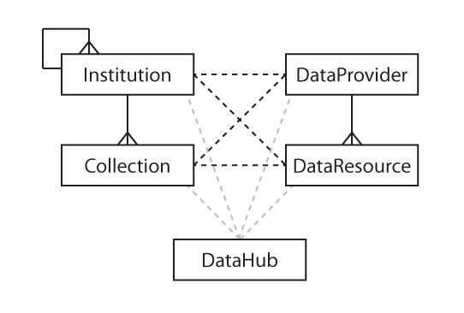
Collectory
Data resources
Collection
Institution
Data provider
Data hub

Slide 17
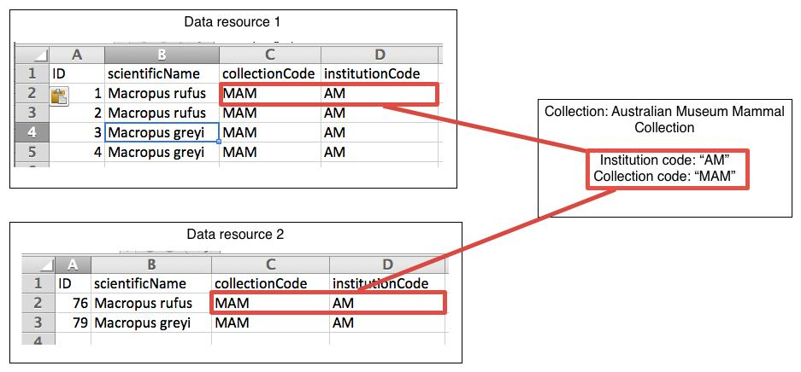
Collectory - data mapping

Slide 18
Collectory
Plugin architecture
Grails plugin - collectory-plugin
Grails template app - generic-collectory
MySQL database
External configuration file

Slide 19
Biocache services
Restful JSON
Search
Web Mapping Services (WMS)
Downloads
Java Spring MVC webapp

Slide 20
Biocache command line tool
Java executable
Scala implementation
External configuration file
Vocabulary files
Loading, processing, sampling, indexing
Other bits
Duplicate detection
Outlier detection

Slide 21
Logging
Download usage
Collection
Institution
Provider
Web services
Collectory pages

Slide 22
Hubs
Occurrence searching & mapping
Grails app
Plugin Architecture
biocache-hubs = the plugin
ala-hub = the one to fork for your project
Internationalisation support

Slide 23
Notes:
Core set of components

Slide 24
Apache Cassandra
Used for occurrence record storage
NoSQL database
Supports simple operations
Get by ID
Put by ID
Range query
Extensible storage

Slide 25
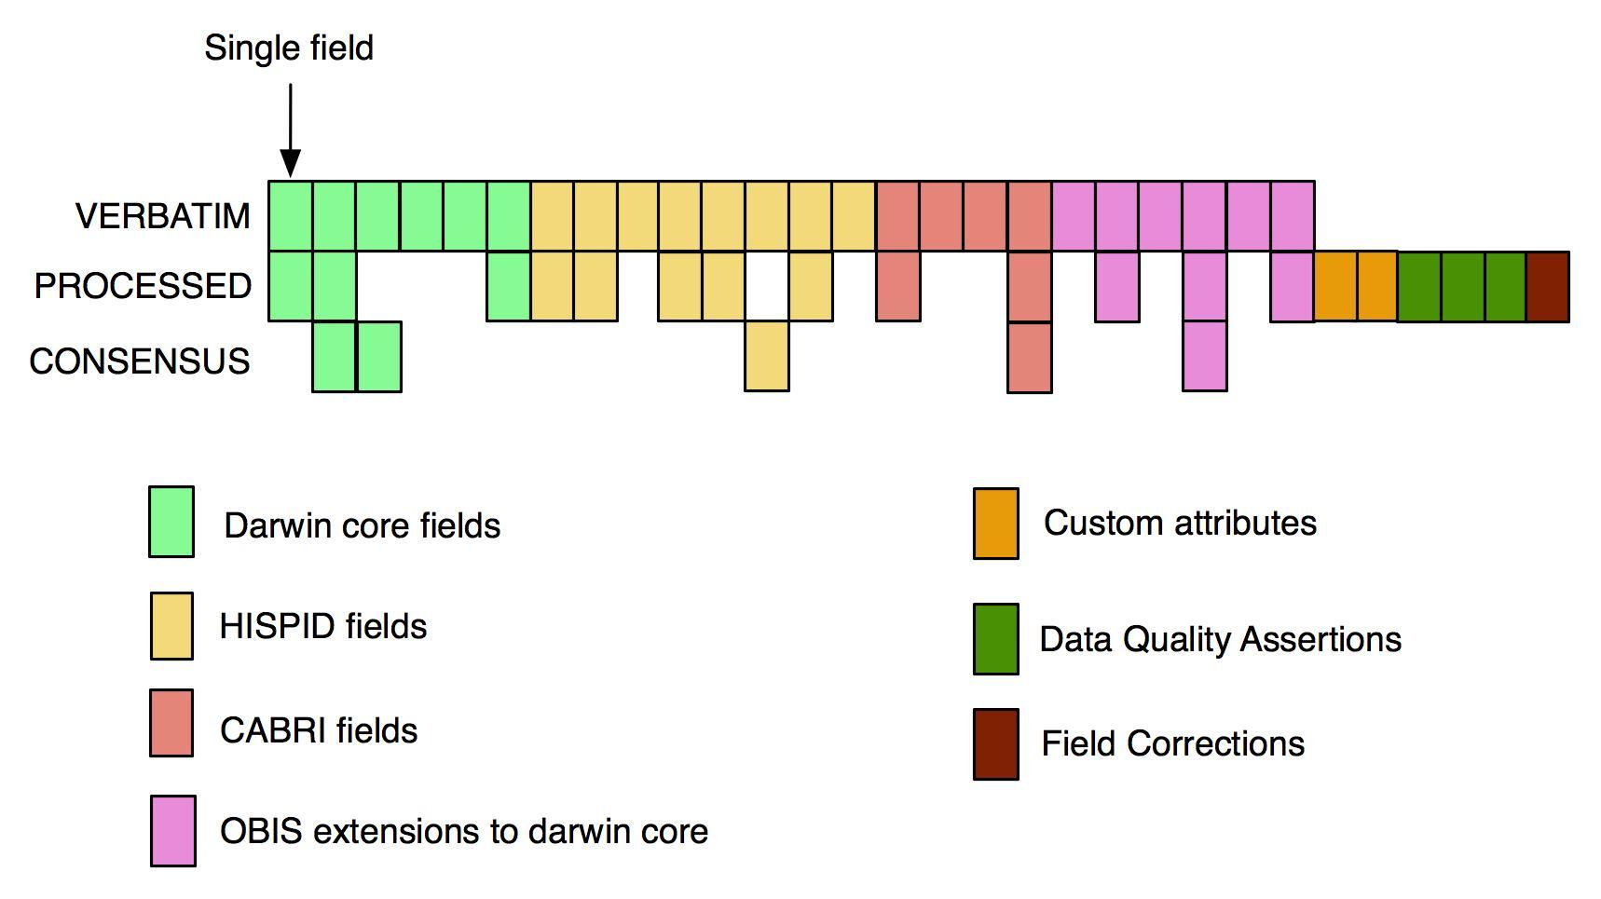

Slide 26
SOLR & Lucene
Lucene index
name matching
generate from DWCA
SOLR
occurrence searching
mapping
update live & offline creation

Slide 27
Taxonomy
Options
GBIF backbone
Catalogue of Life
Your own taxonomy….

Slide 28
Extensions
UI
Customise for your country
Web services
Add additional functionality
Pull request
Merge into core

Slide 29
Infrastructure & setup
Ansible
Virtual machines
Ubuntu
Recommend using cloud provider
Openstack
Amazon EC2
Microsoft Azure

Slide 30
More components
Images
Species pages
Species list
Profiles
Spatial portal

Slide 31
More components
DigiVol
ALA4R
BioCollect
PhyoLink

Slide 32
Demos
https://github.com/AtlasOfLivingAustralia/ala-install/blob/master/TDWG2017.md

