Slide 1
The Demo Architecture
GBIF CESP Workshop, Madrid 2018
Dave Martin

Slide 2
The Demo
EC2 image built for the workshop
Multiple components pre-installed
With Ansible
Inventory & Playbook in ala-install repository
Taxonomy - GBIF Backbone
Name indexes generated
BIE loaded

Slide 3
Subgroups
Each subgroup gets virtual machine
Pre-installed demo using Ansible
Feel free to break it !
We can just create a new one…

Slide 4
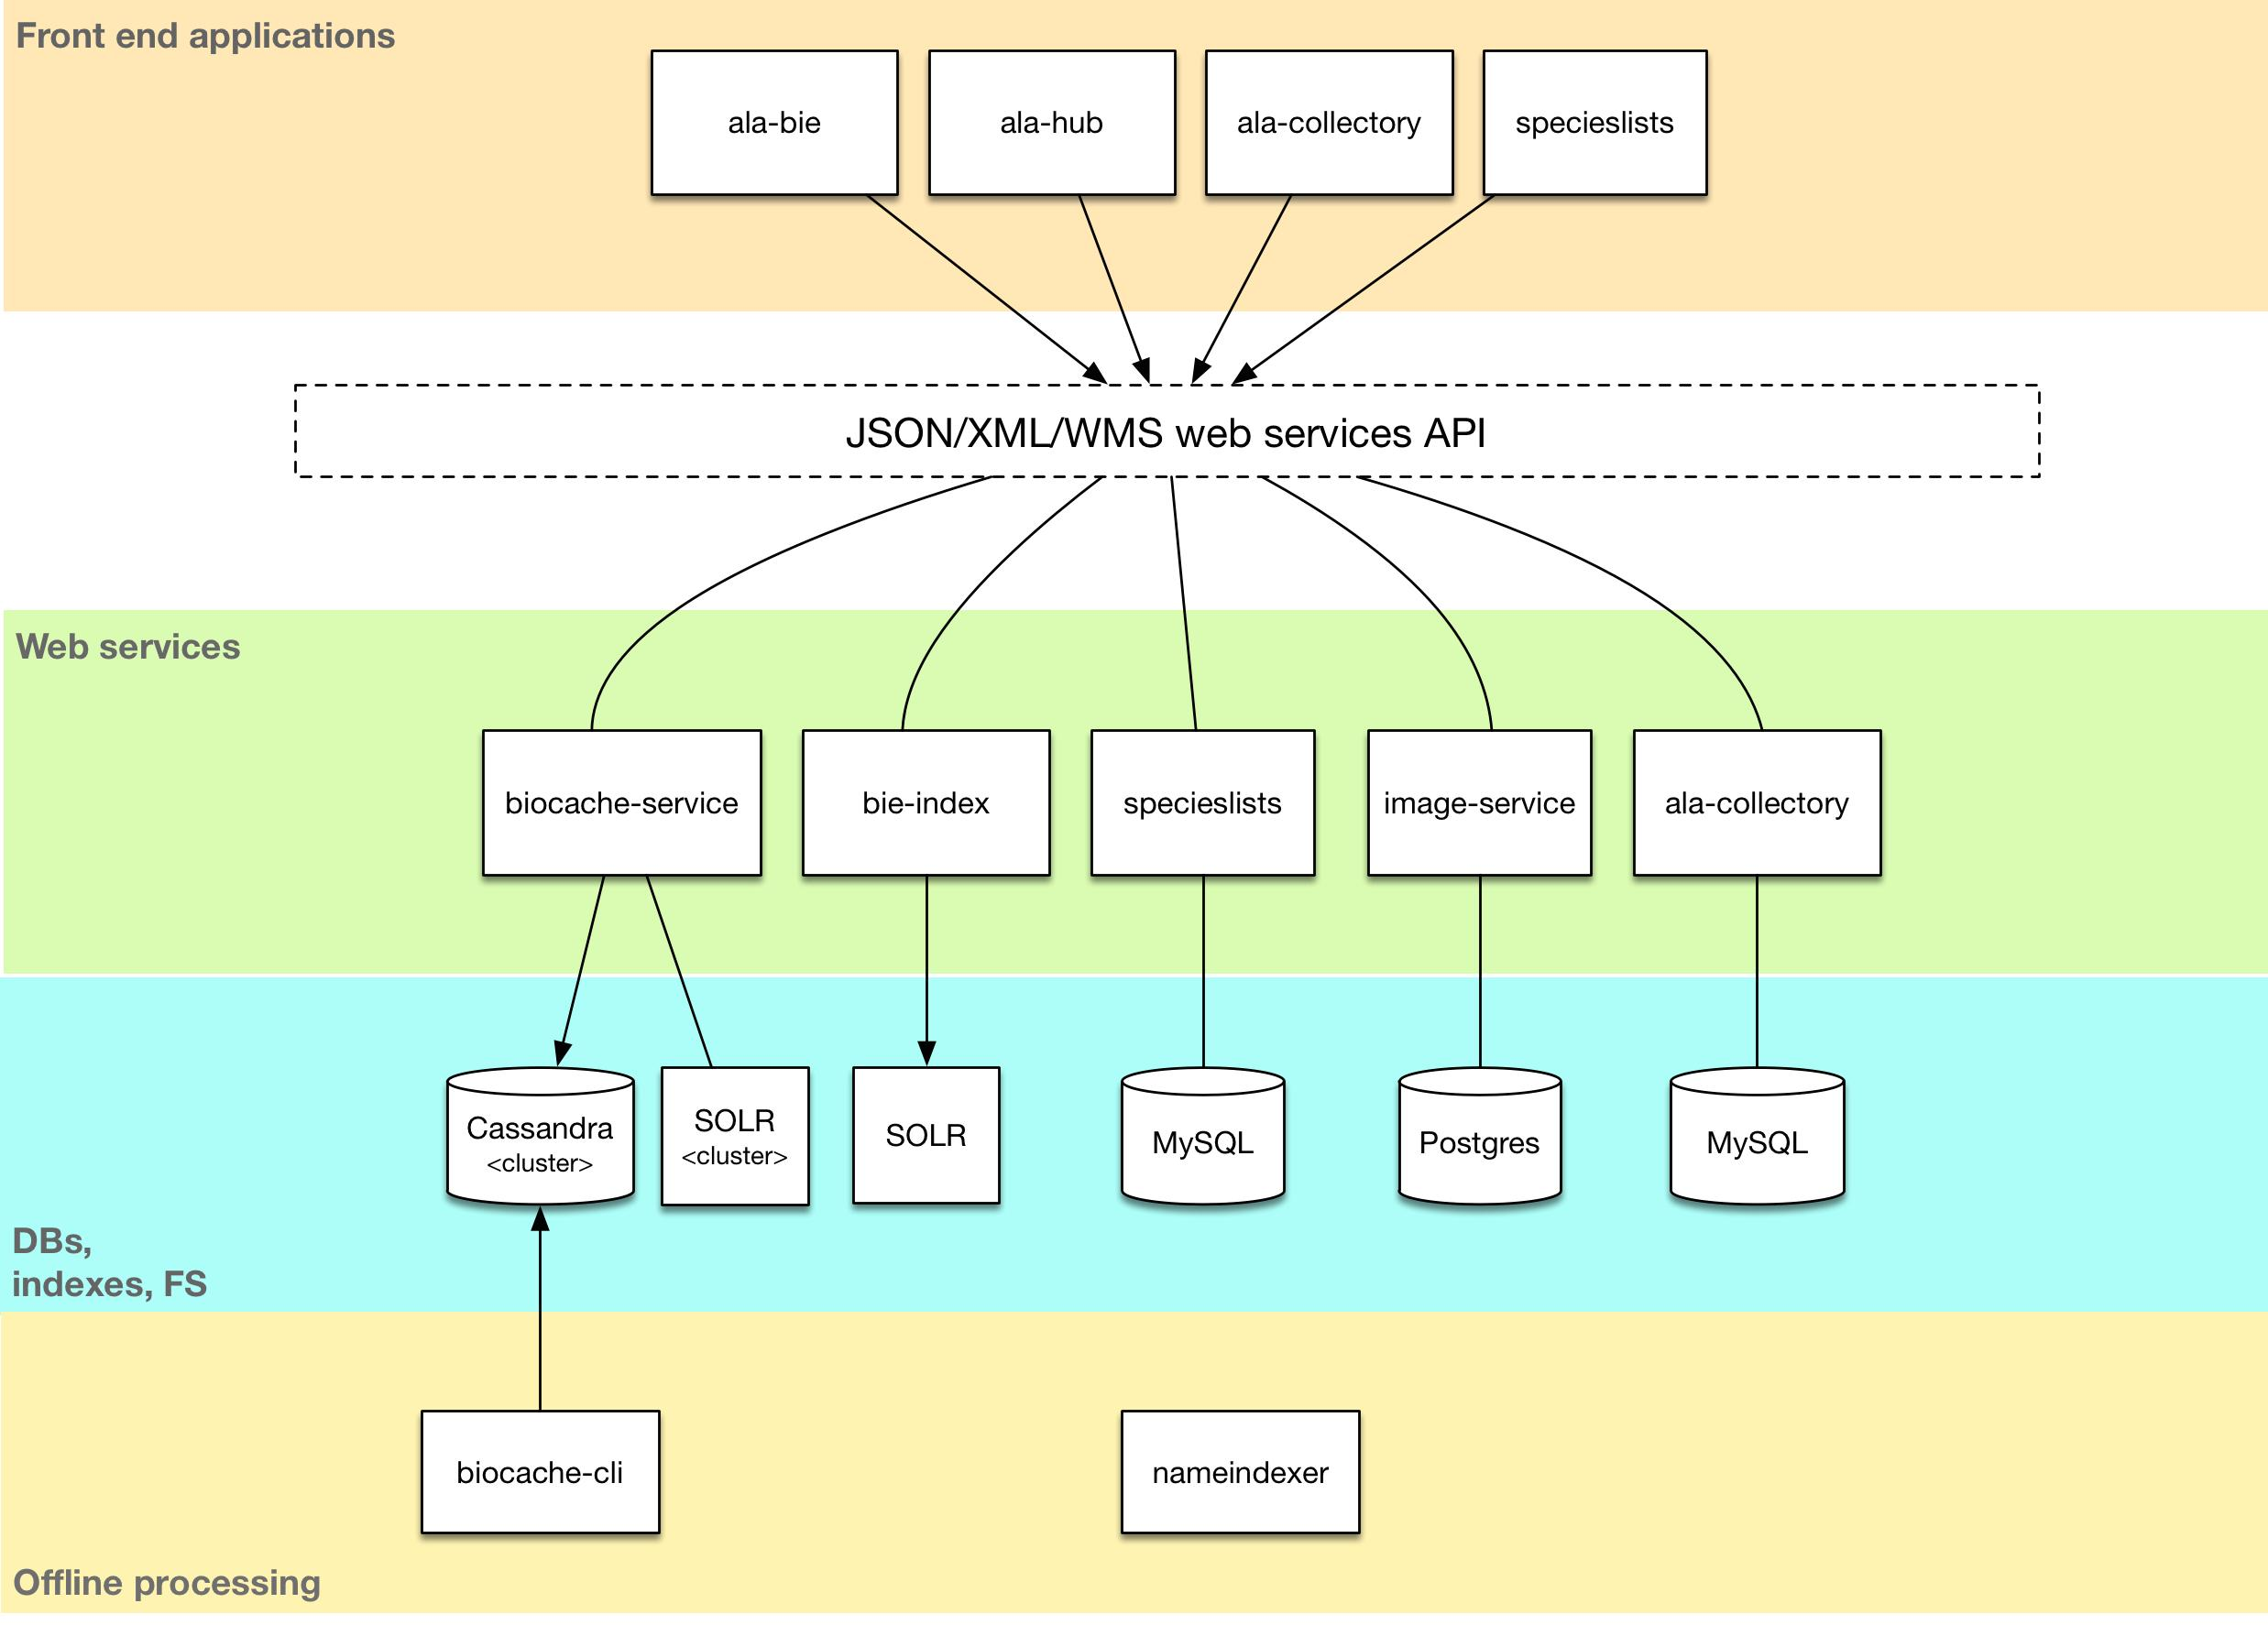
Diagram here of demo….
Notes:
* Microservices architecture
* Lots of components

Slide 5
ALA Demo - components
collectory - metadata registry
biocache services - occurrence services
biocache cli tool - data loading
ala-hub - search UI
ala-bie & bie-index - species pages
species lists - Conservation lists, traits
image services - image serving, tiling
Notes:
We have “ALA Demo” in Github as a starting poing

Slide 6
New components
Cassandra 3
SOLR 6
Bootstrap 3
Grails 3 (and 2.5.x)
ala-hub
ala-collectory
ala-bie
and others….

Slide 7
Skinning / branding
Bootstrap 3 only
banner.html / footer.html / head.html
favicon
Use ala versions
No need to fork generic-hub / generic-collectory

Slide 8
Exercises
Are here: https://goo.gl/9kAKmb

