Slide 1
International Living Atlases Workshop Madrid 2018
Introduction to Grails Nick dos Remedios

Slide 2
Grails
https://grails.org/
“A powerful Groovy-based web application framework for the JVM built on top of Spring Boot”
Convention-over-configuration, sensible defaults, opinionated APIs, and the Groovy language combine to make Grails easy to learn for Java developers
MongoDB, Neo4j and more.
View technologies for rendering HTML as well as JSON
A controller layer built on Spring Boot
A plugin system featuring hundreds of plugins.
Flexible profiles to create applications with AngularJS, React and more.
An interactive command line environment and build system based on Gradle
An embedded Tomcat container which is configured for on the fly reloading

Slide 3
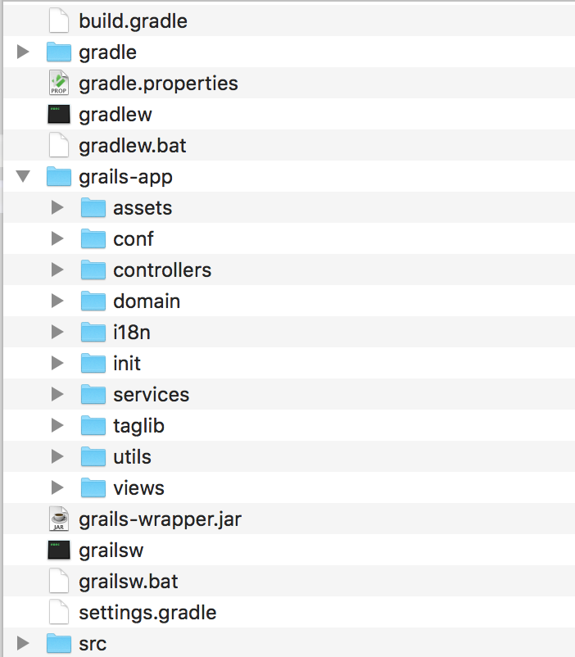
File Structure
$ grails create-app au.org.ala.testApp

Slide 4
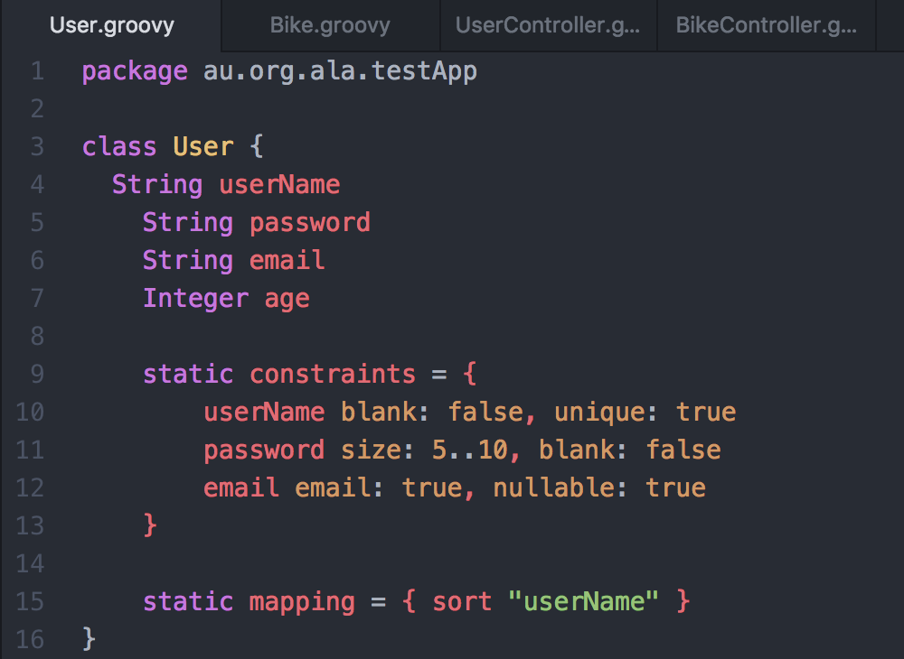
Example classes
$ grails create-domain-class au.org.ala.testApp.User

Slide 5
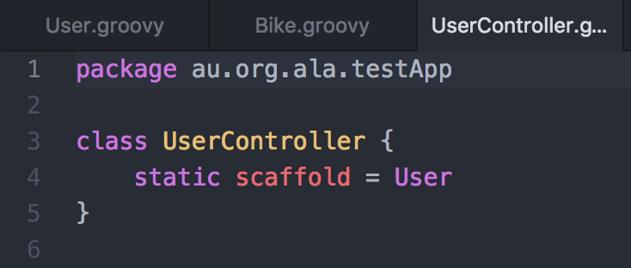
Controller
$ grails create-controller au.org.ala.testApp.user
$ grails run-app
$ Grails application running at http://localhost:8080 in environment: development

Slide 6
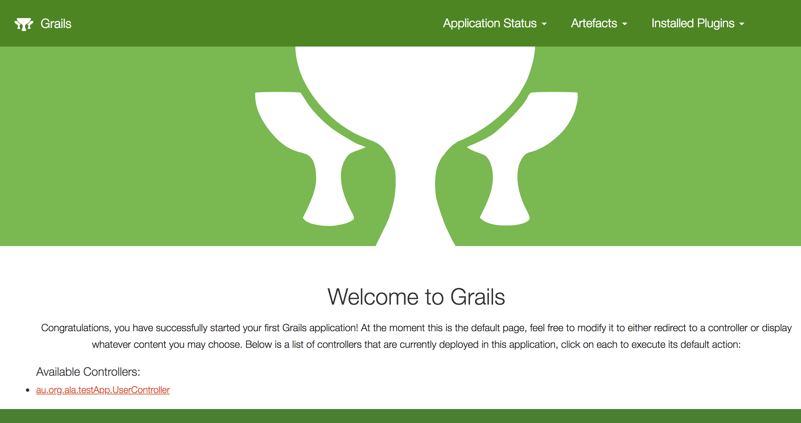
testApp running

Slide 7
Files you may need to edit
build.gradle -- version, package, library dependencies
grails-app/conf/application.[groovy|yml] -- configuration (defaults)
grails-app/assets/[stylesheets|javascript|images]
grails-app/i18n/messages.properties -- internationisation (translation) files
grails-app/views/layouts -- header & footer (not needed for new version)
grails-app/controllers/.../UrlMappings.groovy -- custom URLs

Slide 8
Plugins
Plugins allow the “client” application to override/customise functionality and still allow changes to core changes to be maintained
Break large app into smaller parts
Common components
Third party plugins
Grails plugins and applications are mostly the same - minor differences in a few files but directory structure is the same
Client app only needs to implement files that are different to the plugin, all other files are inherited
May need to break large GSP files into smaller “include” files (e.g. _advanced.gsp)

